Slide 1
Foundations and Resources for the Community
Professor Awais Rashid

Slide 2
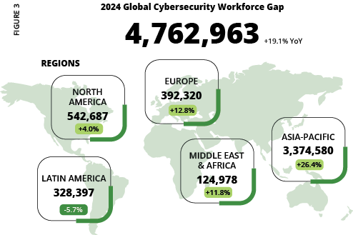
~4 Million
2023
~3.4 Million
2022
~2.72 Million
2024 ISC2 Cyber Workforce Study
2021

Slide 3
“The proportion of UK businesses with basic and advanced technical skills gaps has not changed significantly across the 6 years of data.”
~44%
~27%
Businesses with basic skills gaps
Businesses with advanced technical skills gaps
DSIT Cyber Security in the UK Labour Market Report 2024

Slide 4


Slide 5

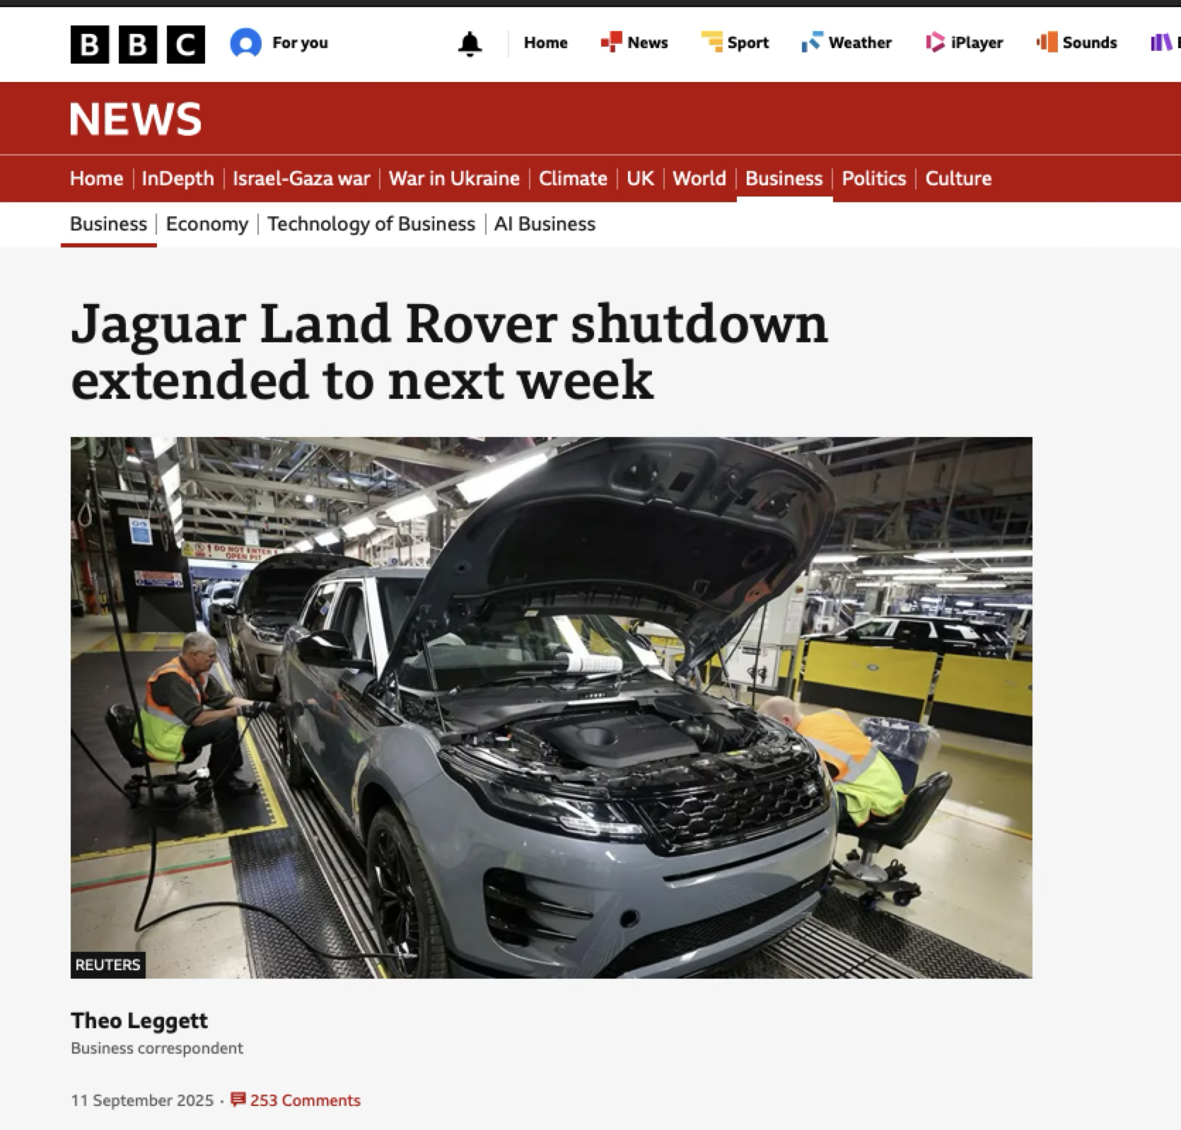
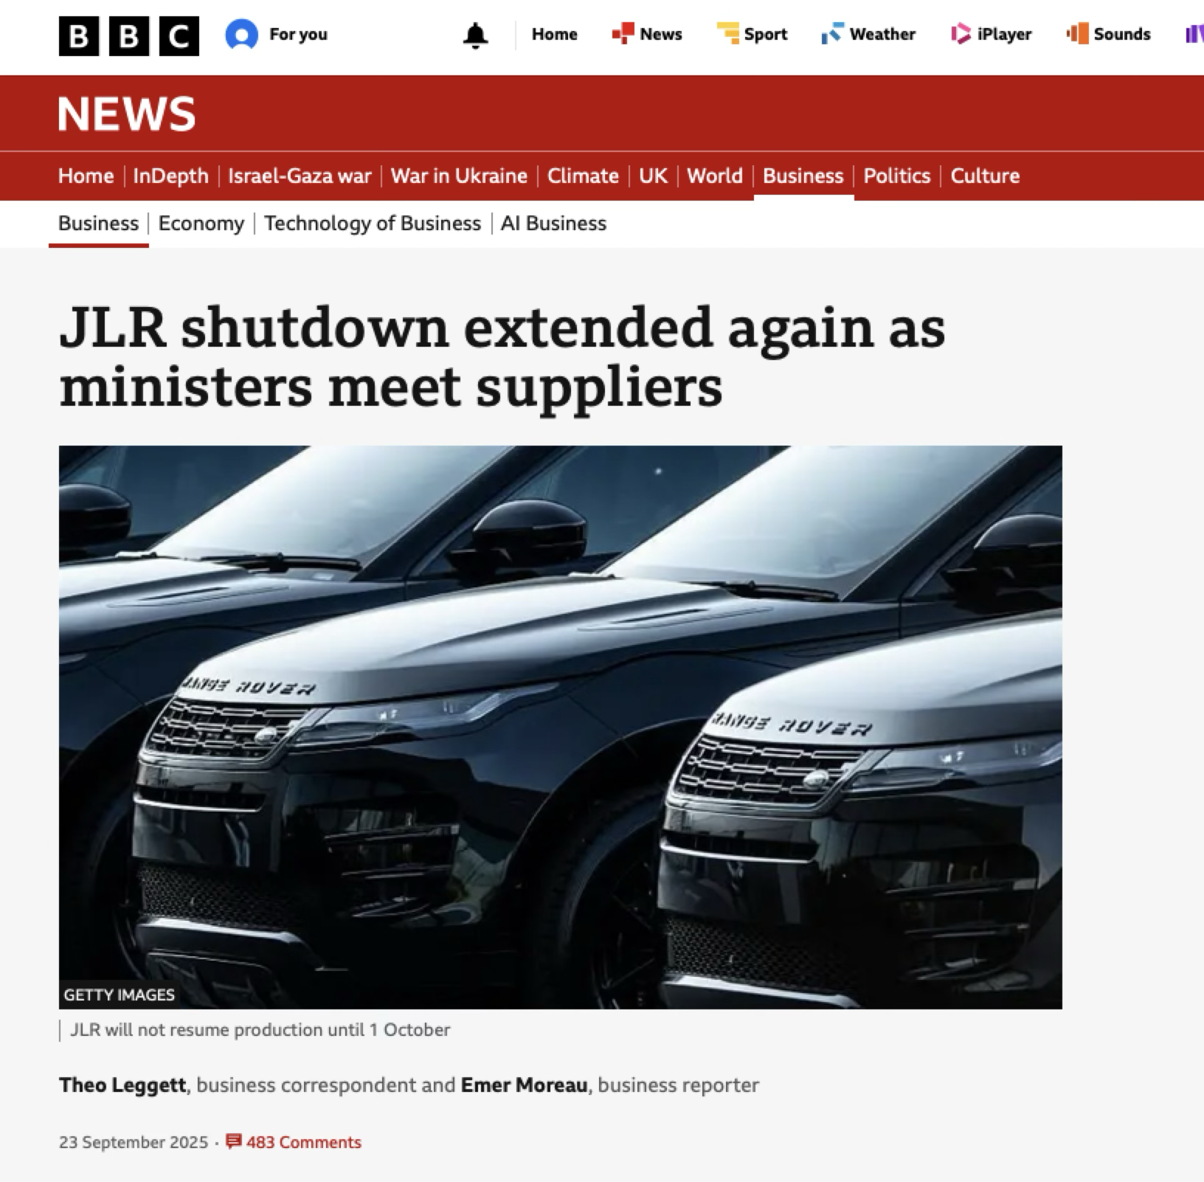
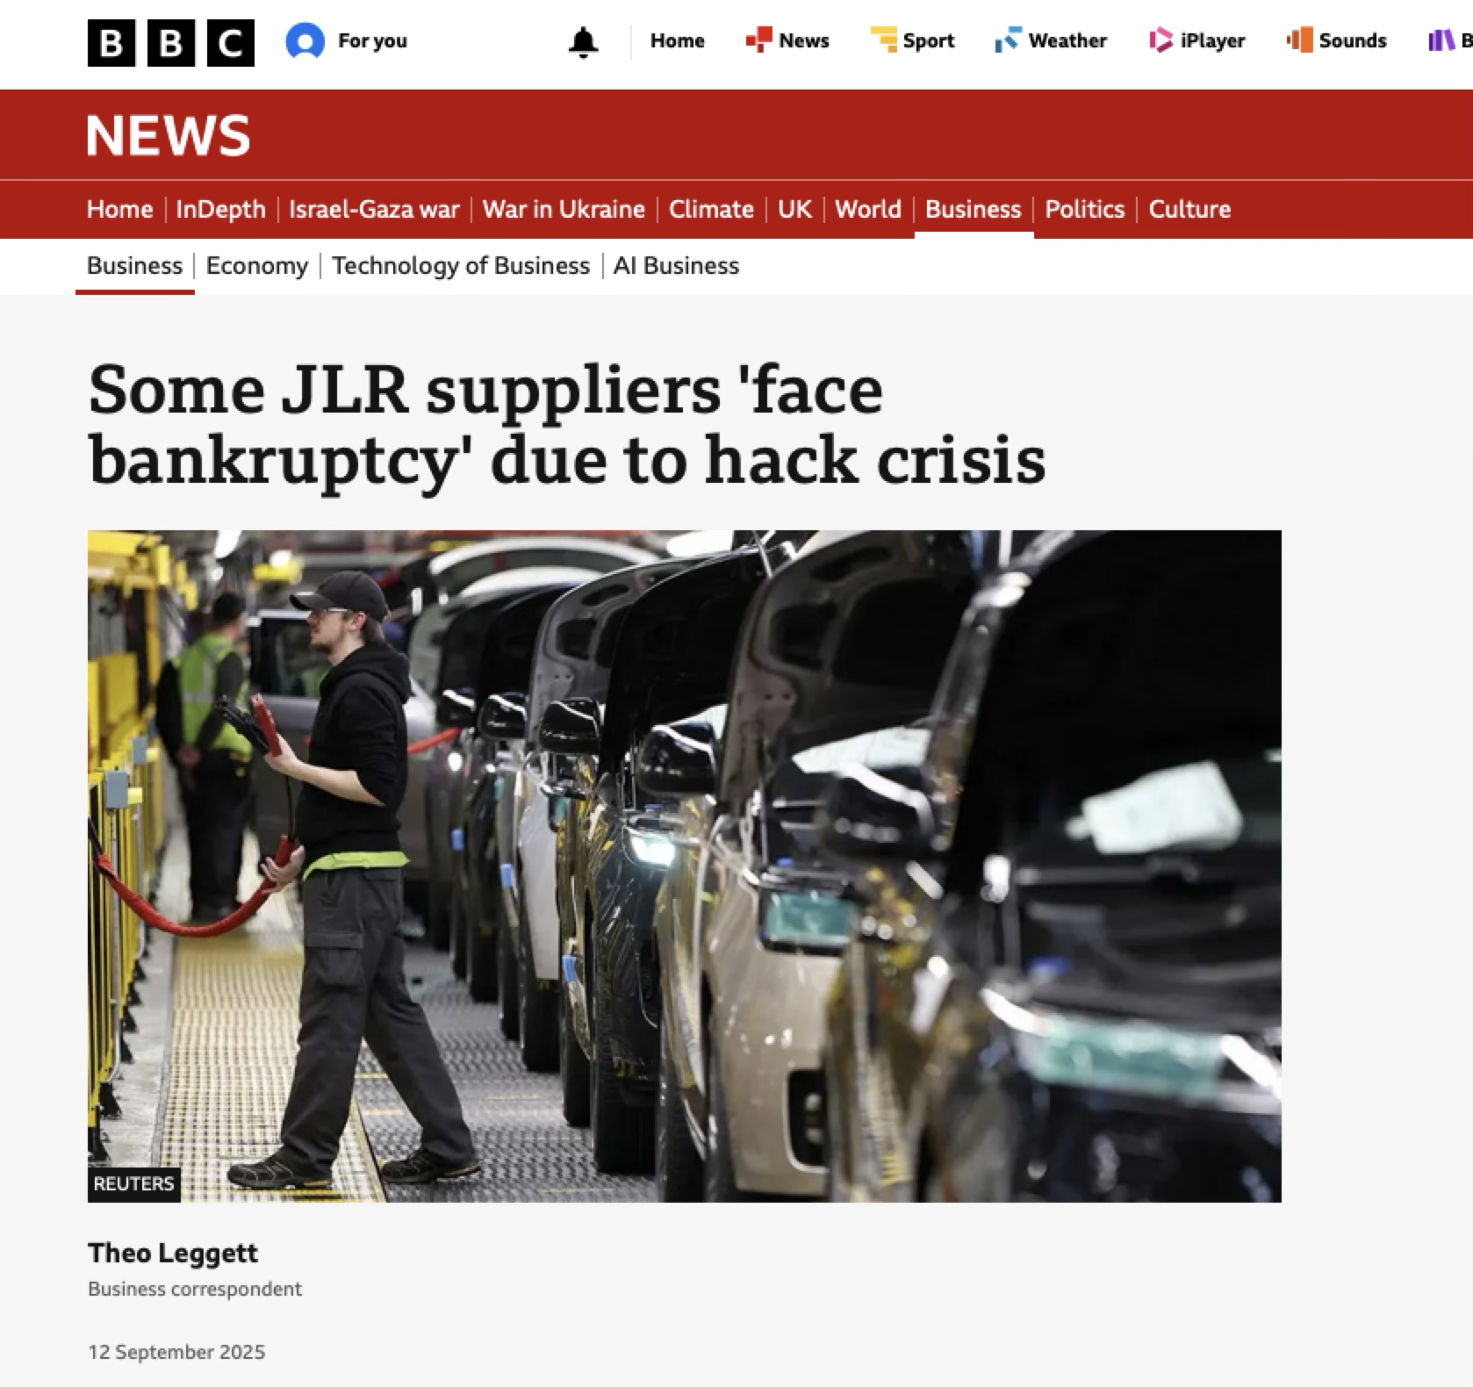

Slide 6
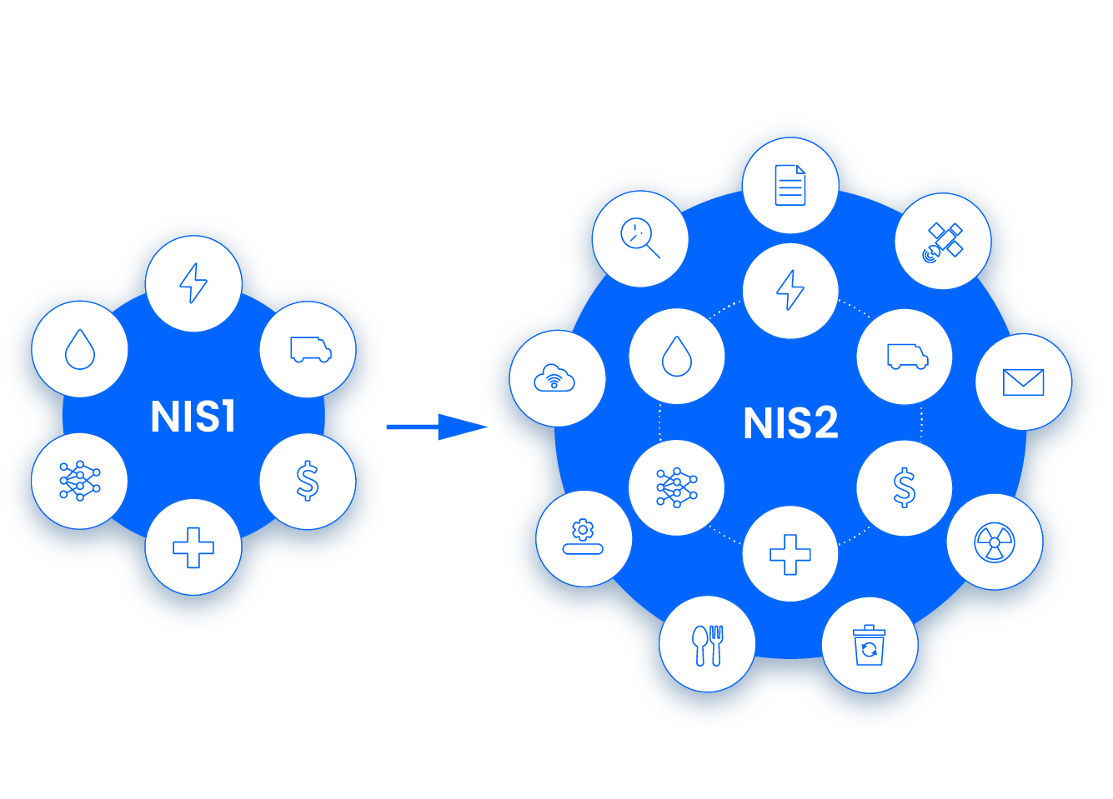

Cyber Security & Resilience Bill

Slide 7




Cyber Security Skills
Knowledge

Slide 8

Cyber Security Skills

Slide 9
CyBOK 1.1
Notes:
Provide an overview of knowledge areas and categories in the diagram

Slide 10
Codify foundational and generally recognised knowledge in cyber security following broad community engagement nationally and internationally
A guide to the body of knowledge
Focus is on established foundation of the subject (not on everything that has ever been written or on still-emerging, nascent, topics)

Slide 12
>115
>1000
>2200
>1600
>30
Experts: Authors, Reviewers, Advisors
Pages
Authoritative sources
Comments from wider community
Invited talks, panels and keynotes

Slide 14
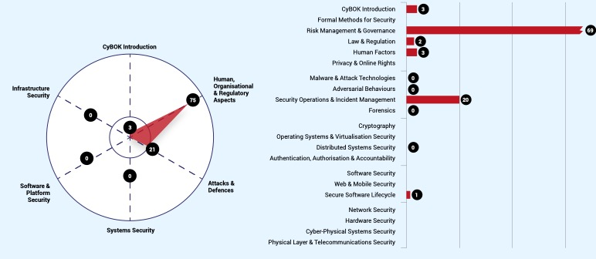
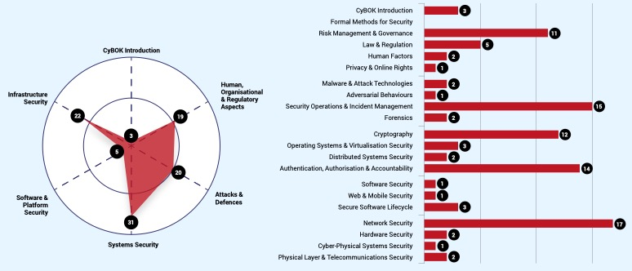
Learner, Recruiter, Certification Body

Slide 15
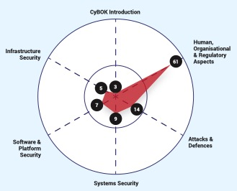
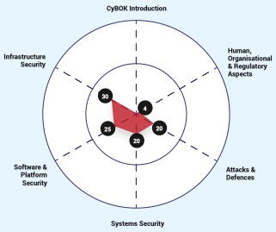



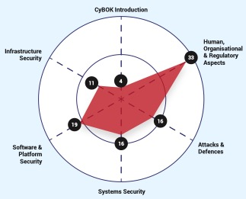

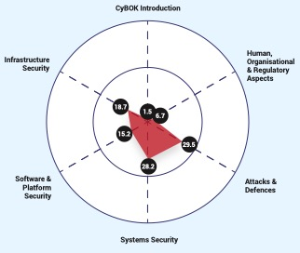
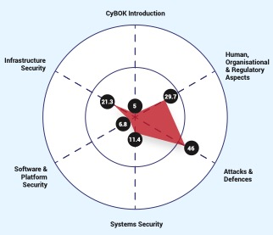

Notes:
Cumulative knowledge of an individual is a union of the knowledge acquired through certifications, training, experience and job responsibilities.

Slide 16
…
Notes:
Cumulative knowledge profile of an organization or team is a union of the knowledge profiles of the employees/team members

Slide 17






Practical exercises, labs and CTFs
Course Shells
Case studies
Outreach resources
Reports on relevant topics

Slide 18
From
To
Long term
Sustainability
The Project
Community Interest Company
Transition
Summer 2026
Ongoing work for

Slide 19
CIC
The Project

Slide 20
CyBOK CIC
Vision: A world where Cyber Security capability gaps are eliminated
Key Principles: Editorial independence
Created and shaped by the community
Open for everyone to access
Rigorous
Constantly current
Freely available

Slide 21








CIC
Technical Infrastructure
Governance
Services
People
Revenue

Slide 23
Community Interest Company

Slide 24

Service Users
Collaborators
Sponsors
Supporters
Partners
CIC
Community Interest Company

Slide 25
Cyber Security Body of Knowledge
Global ・ Foundational ・ Rigorous

