Slide 1
Open Source CyBOK Practical Challenges and Learning Resources
Dr. Z. Cliffe Schreuders

Slide 2

Open Source CyBOK Practical Challenges and Learning Resources
SecGen
Open source framework for generating randomised challenges and VMs
https://github.com/cliffe/SecGen
BreakEscape
Cyber security game framework
https://github.com/cliffe/BreakEscape
Mapped to CyBOK

Slide 3
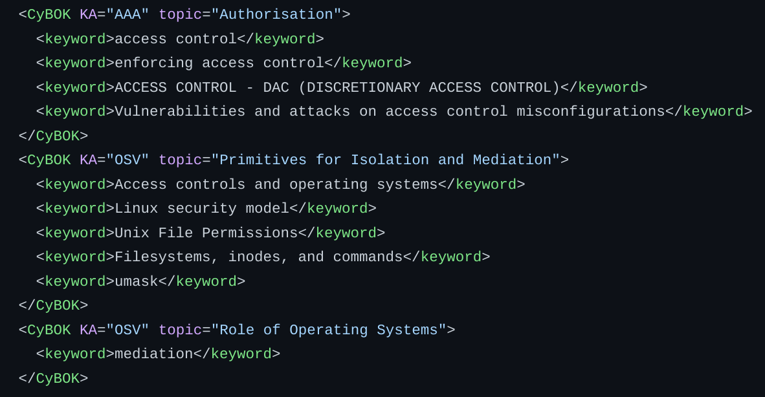
SecGen: A huge open source library of content mapped to CyBOK
SecGen generates randomised VMs, meaningful security challenges, and CTF scenarios
Randomisation
Content is mapped to CyBOK
150+ Labs and multi-step CTFs, with randomised CTF challenges
CyBOK enables us to understand what areas of knowledge are covered by modules, and also track each learner's progress

Slide 4
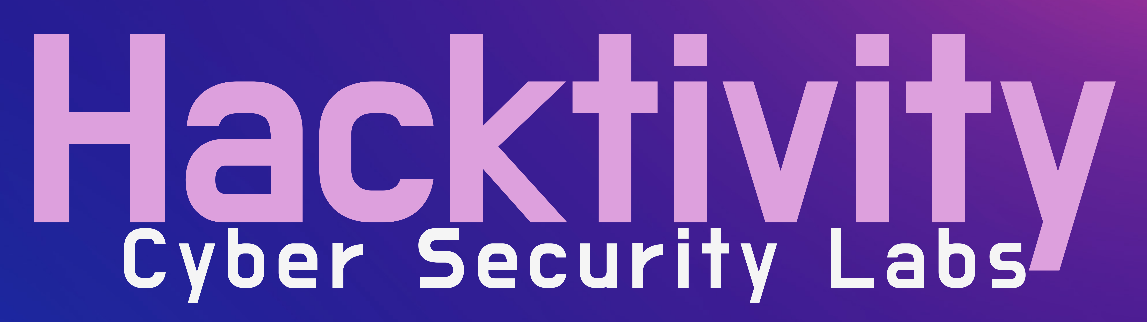

Hacktivity Cyber Security Labs
Hacktivity is our online lab platform
Powered by SecGen
For individuals and organisations
https://hacktivity.co.uk

Slide 5
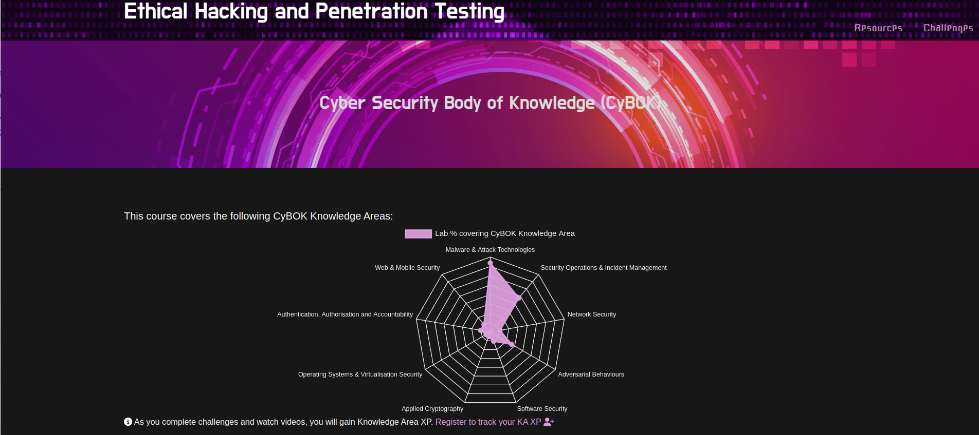

CyBOK: module mapping

Slide 6
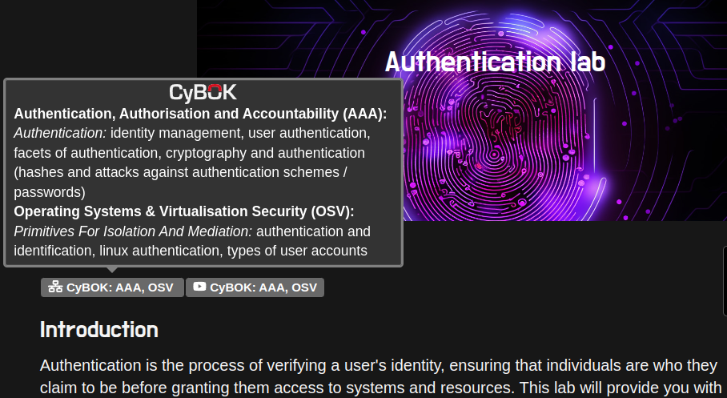
CyBOK: lab and lecture mapping

Slide 7
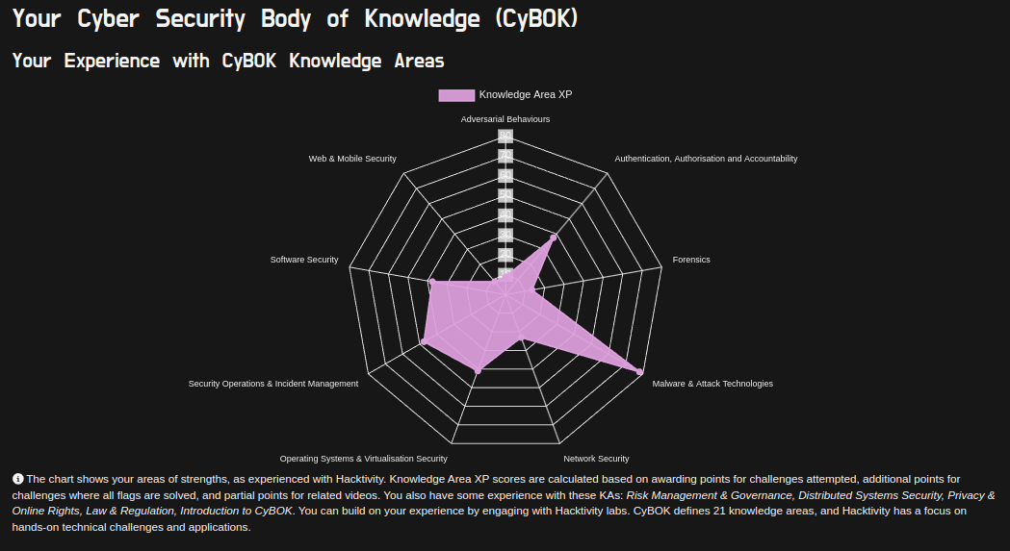
CyBOK is used to track personal progress

Slide 8
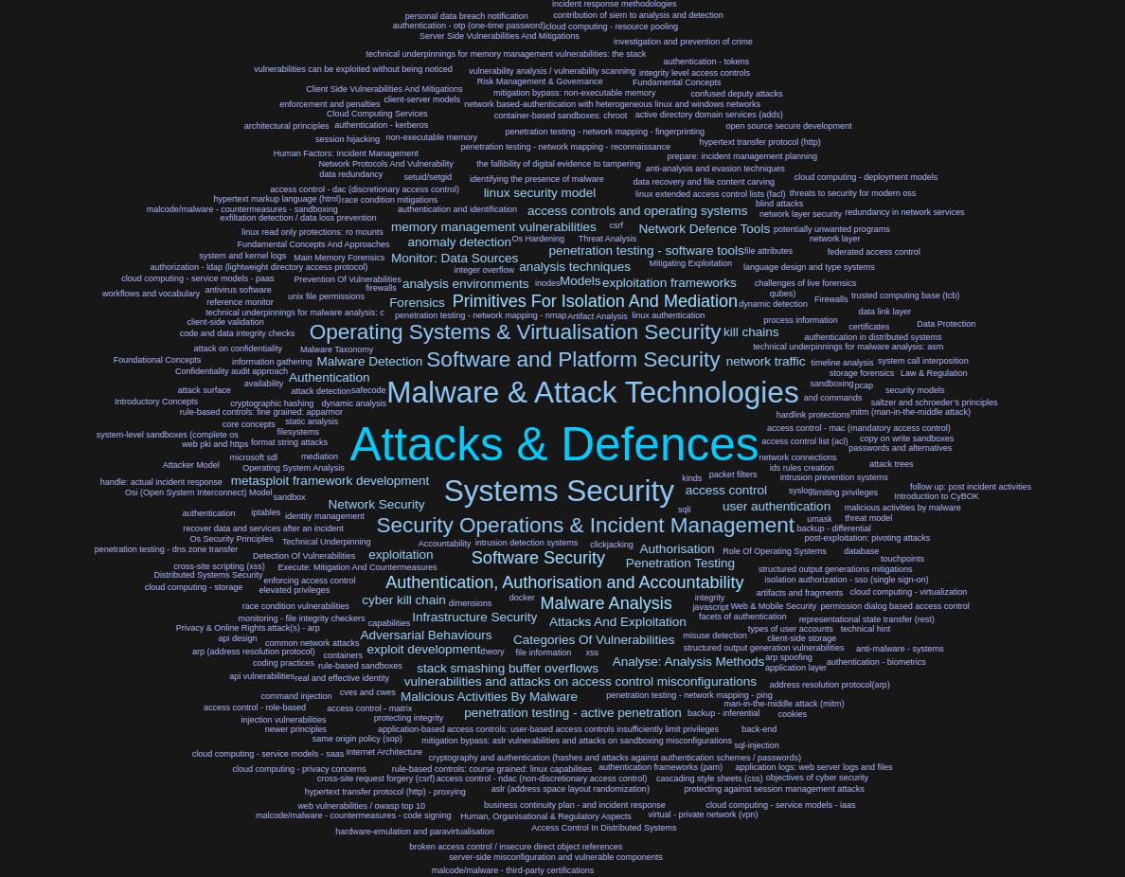

Slide 9
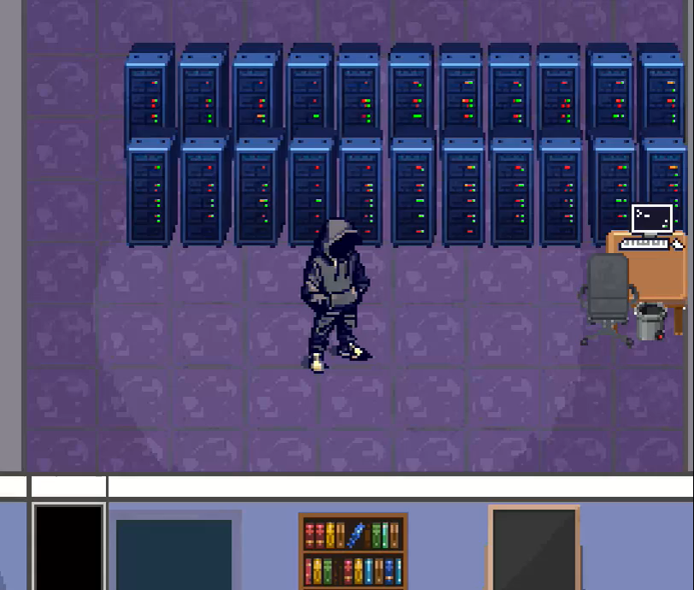
Introducing BreakEscape
Cyber security game
Physical and digital security
Narrative-driven scenarios
Designed to be extensible
Cyber security theme and gameplay

Slide 10
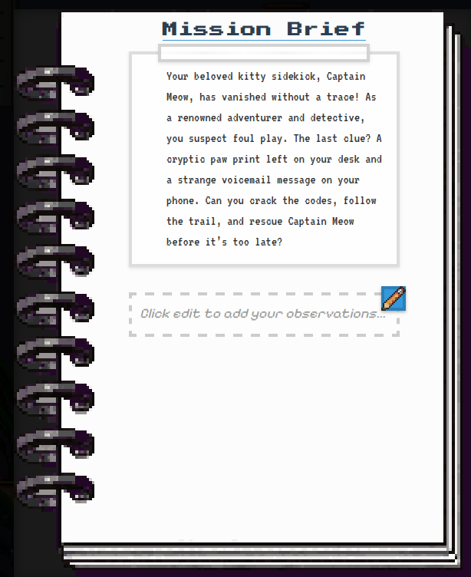
Inspiration & Design Philosophy
Inspired by:
Escape rooms and escape boxes
Capture the flag (CTF) challenges
Retro top-down games and dungeon crawlers
Aims to be:
Fun and engaging
Educational
Accessible to various skill levels
Easy to deploy and extend

Slide 11

Games-Based Learning (GBL)
Using games to enhance learning
Constructivist learning principles
Active engagement through puzzle chains
Critical analysis and practical application of knowledge
Addresses the "reflection gap" identified in many existing security games

Slide 12
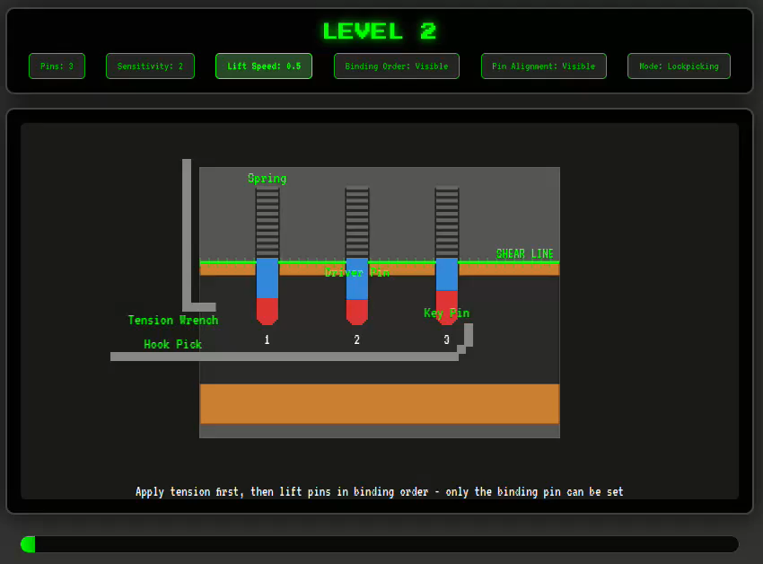
Implementation
Implemented using Phaser.js (JavaScript game framework) -- runs via web browser
Flexible range of security mechanisms for doors, items/devices, and containers
Pin tumbler locks
  Keys and lockpicking
PIN/password locks
Biometric authentication
  Fingerprints can be dusted and spoofed
Bluetooth proximity detection
CyberChef integration for cryptographic challenges

Slide 13
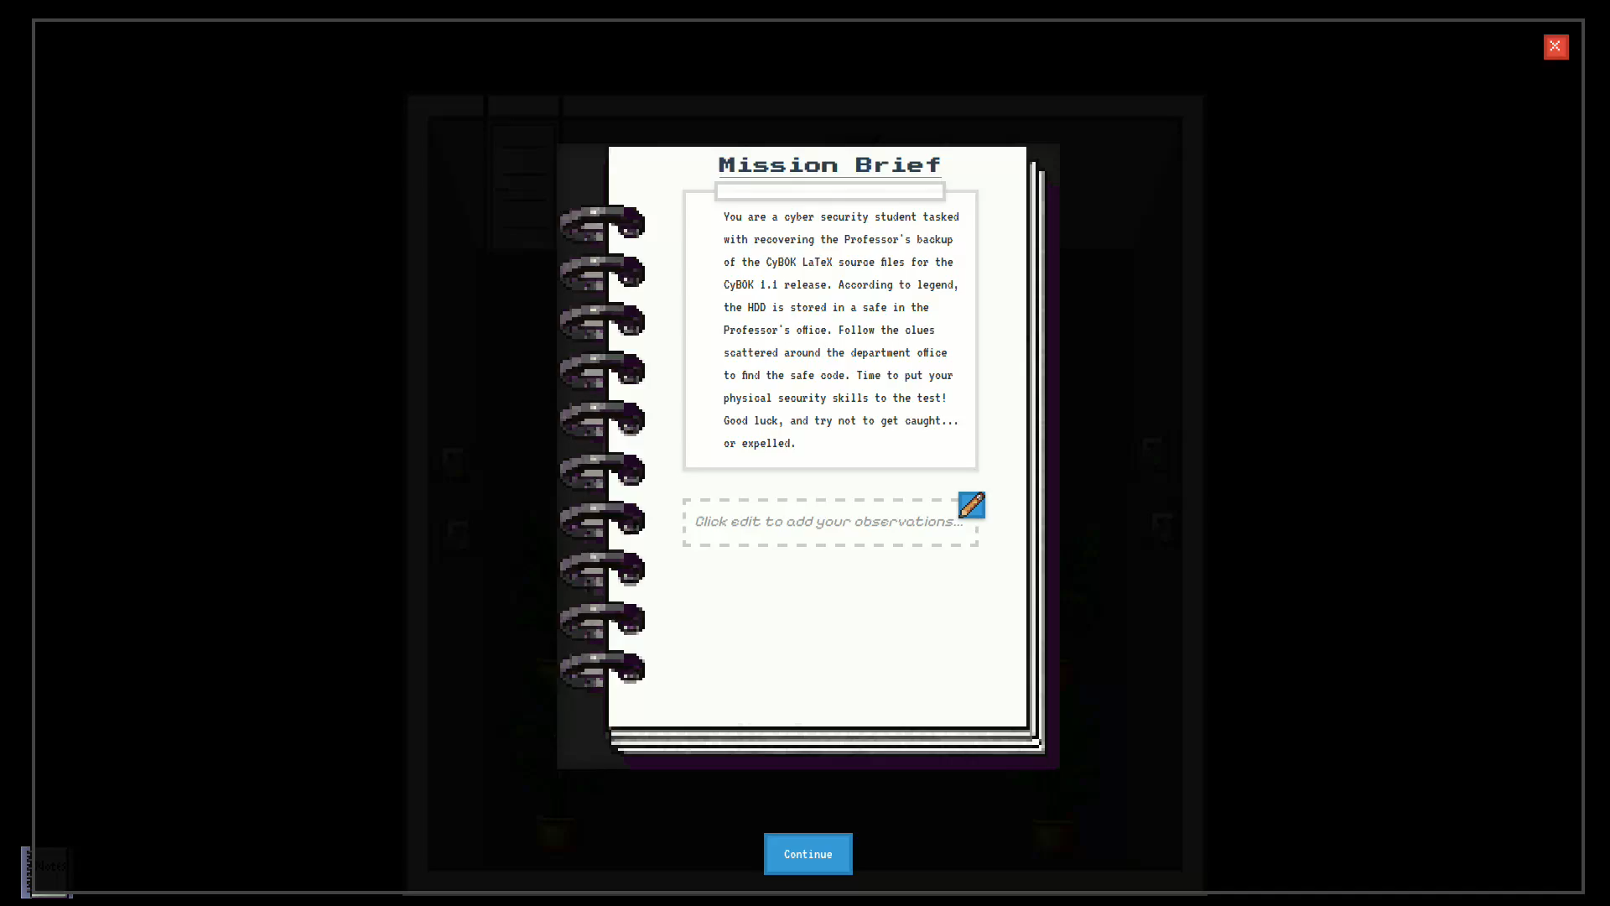

Slide 14
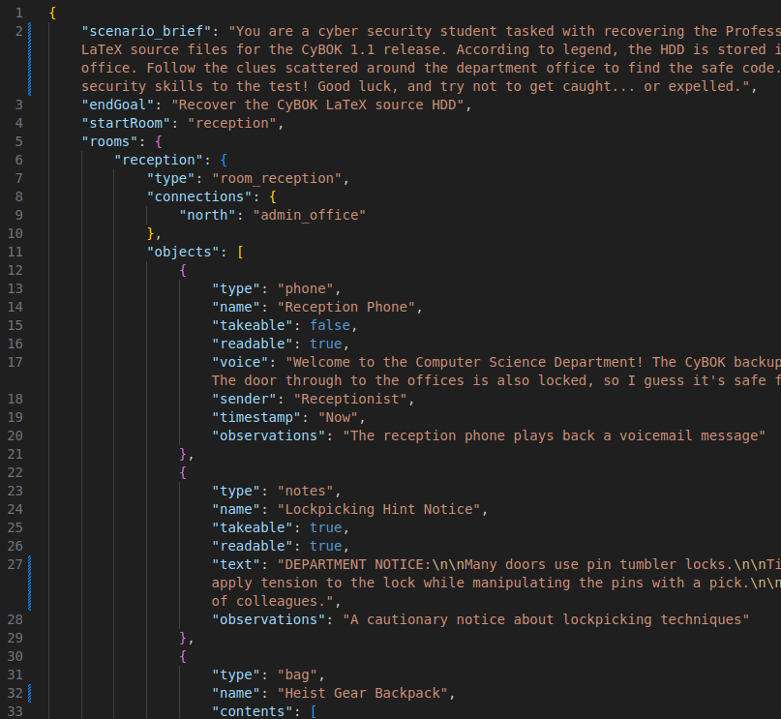
Scenario Creation
JSON-based specification format
No programming or game design tools required
Components include:
  Scenario brief (narrative context)
  Room definitions with connections
  Objects (type, properties, locks)
  Puzzle chains and dependencies
  CyBOK knowledge area mappings
Educators can create custom scenarios by editing JSON files
Community can build and share

Slide 15

Active road map
We are working on:
More scenarios and KAs
Integration with SecGen for real VM-based challenges
Integration with Hacktivity Cyber Security Labs platform
More items and mini-games and security mechanisms
NPCs with branching dialogue
Server-side validation of solutions and progress-based room data

Slide 16
Free and Open Source
https://github.com/cliffe/BreakEscape
Easy to self-host
We also host a copy, so you can follow the link to play in your browser

Slide 17
Conclusion
We publish extensive open source learning resources, mapped to CyBOK:
  SecGen:
    https://github.com/cliffe/SecGen
  BreakEscape:
    https://github.com/cliffe/BreakEscape
Hacktivity provides a fully hosted lab experience
  with CyBOK at the forefront of the user experience
  https://hacktivity.co.uk

