Slide 1
ITSUS Consulting
ITSUS Consulting
Secure Communications
Expertly Delivered
Secure Communications
Expertly Delivered
COPYRIGHT © 2014 ITSUS CONSULTING

Slide 2
CyBOK Workshop for Local Authorities / Education
Thinking outside the (Cy)BoX
Dr Clare Johnson | Dr Jack Whitter-Jones | Andrew Johnson
CyBOK © Crown Copyright, The National Cyber Security Centre 2023, licensed under the Open Government Licence: http://www.nationalarchives.gov.uk/doc/opengovernment-licence/.
When you use this information under the Open Government Licence, you should include the following attribution: CyBOK Workshop for Local Authorities / Education © Crown Copyright, The National Cyber Security Centre 2023, licensed under the Open Government Licence http://www.nationalarchives.gov.uk/doc/opengovernment-licence/.

Slide 3
CyBOK Overview: What is CyBOK?
The CyBOK is a comprehensive body of knowledge for the Cyber Security sector. Designed to underpin education and professional training, it details 21 knowledge areas that encompass all aspects of cyber security, from Risk and Governance through to Cryptography and Cyber Physical Systems.
The CyBOK is well recognised in the educational sector and underpins a variety of degree programmes in UK universities including NCSC Certified Degrees. Its application to the wider community is less well established despite being of potentially significant benefit.
This project aims to explore CyBOK with established partners in the Education and Local Authority sectors, focusing on raising awareness of the resource, developing understanding of how it can best be applied to these sectors, and developing draft resources and recommendations for wider use within the sector.
Notes:
Comprehensive body of knowledge (BOK).
Underpins education & professional training.
21 KAs across 5 categories (later slide).
Collaboration of 115+ world experts.
Underpins degree programmes in UK Universities.
Its application across wider community is less established. (Hence this project).

Slide 4
CyBOK Overview: Target audience
Senior staff from IT teams within Education Providers
Local Authority IT teams with responsibility for Education IT
Governance teams
Welsh Government Local Authority / Education staff with responsibility for Cyber Security and Cyber Resilience

Slide 5
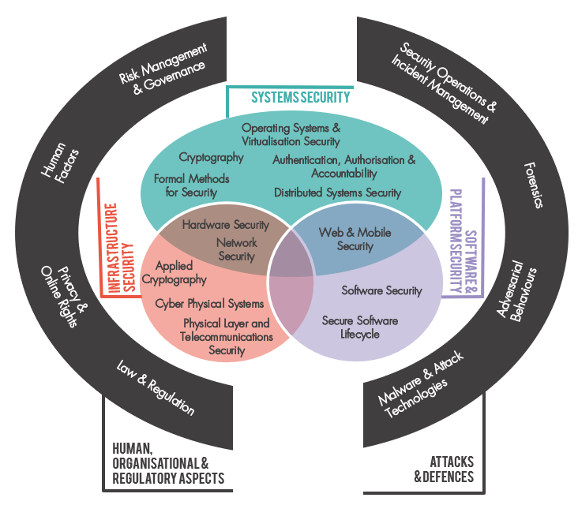
CyBOK Overview: Knowledgebase Areas
Notes:
Our chosen KAs under the first phase of this project:
Adversarial Behaviours
Human Factors
Malware & Attack Technologies
Security Operations & Incident Management
Why?
These KAs represent the steps involved in a security breach/cyber attack.
i.e. Adversary is the threat>
Human Factors provide the (human) opportunity for an attacker>
Malware is the source>
Security Operations is the protection and response.

Slide 6
Scenario 1.1: Adversary – Helen Back (IT Analyst) KA: https://www.cybok.org/media/downloads/Adversarial_Behaviours_v1.0.1.pdf
Helen Back is an IT Analyst who has worked for Mordor District Council for 3 years. During her employment, Helen has had multiple disagreements with her management team, colleagues and has had several altercations with management regarding her working environment, her daily workloads, and her personal development. During her last personal development review, Helen was not offered a pay increase and was not offered a promotion internally to become a senior IT analyst. In addition, there are internal ‘whispers’ of redundancies within the IT Support department due to an internal restructure.
Helen Back is an example of a disgruntled employee. She has given in her notice, and on the day she leaves the office she plants a malicious ‘leaving present’ - The ‘Rubber Ducky’ USB.
A rubber ducky USB will emulate a user's keyboard when plugged into a USB port and can be used to execute commands and execute malware. In this context , Helen has uploaded an executable ransomware onto the USB disguised as a pdf file entitled ‘Redundancies 2023’. The USB has been labelled as ‘Redundancies 2023’ and Helen has left it in the IT Support department’s kitchen just before she leaves for good. Helen is also aware that Evan takes an early lunch break at 12:00.
Discussion Point – Why do you think Helen is behaving in this manner? What security processes should be in place to protect the organisation from potential adversaries such as Helen?
Notes:
Hand out laminated version of this for groups to read. Collect discussion notes after 15min.
Adversarial behaviours – prompts to help discussion:
Who and why
How

Slide 7
KA – Adversarial Behaviours: Characteristics of Adversaries: Cyber-Dependent/Enabled Crime https://www.cybok.org/media/downloads/Adversarial_Behaviours_v1.0.1.pdf
Organised Crime
Cyber Enabled Criminals
State Actors
Sabotage
Interpersonal Offenders
Espionage
Disinformation
Cyber Dependent Criminals
Hacktivists
Organised Crime
Data Leaks, DoS, Web Defacement
Notes:
Scenario 1.1 relates to the Adversarial Behaviours KA. Understanding why people engage in these behaviours, and what format that might take can help organisations mitigate some attacks and prepare for them should they occur.
It is useful to discuss the following:
Describe the difference between cyber-enabled and cyber-dependant. i.e. Cyber-enabled is the use of the internet, whereas cyber-dependant is the use of electronic devices.
State Actors are the APTs of the adversaries.
Hacktivists, although generally less of a threat can still do significant damage.
Helen Back was using a USB rubber ducky, so was a cyber dependent criminal. Although she was not a ‘state actor’ she committed sabotage.
It may also be useful to mention:
Attack trees
Kill chain (covered in more detail later)

Slide 8
Scenario 1.2: Human Factor – Evan Lee – IT Support Analyst KA: https://www.cybok.org/media/downloads/Human_Factors_v1.0.1.pdf
Evan Lee is the newest member of the IT Support team at Mordor District Council. Evan has only been with the council for 6 months and has recently bought a house as he has passed his probation. However, talk amongst the department colleagues regarding upcoming redundancies has left Evan worried that he may lose his job as he is the newest member of the team.
Evan is the unfortunate victim in this scenario: on his lunch break he finds the Rubber Ducky USB in the kitchen labelled ‘Redundancies 2023’, curiosity gets the better of him and he takes the USB.
Discussion Point – What factors do you think are contributing to Evan’s behaviour?
Notes:
Hand out laminated version of this for groups to read. Collect discussion notes after 15min.
Human Factors – prompts to help discussion:
Who is the victim?
Why?
Could his actions have been discouraged and if so, how?

Slide 9
KA – Human Factors: Understanding Human Behaviour in Security https://www.cybok.org/media/downloads/Human_Factors_v1.0.1.pdf
Exploit
Alter
Social Context:-
Organisation, Colleagues
Impact
User’s perception
Disrupt tasks required to achieve goals
Notes:
Scenario 1.2 relates to the Human Factors KA. Human factors are of significant importance in cyber security, though often overlooked. Areas from the KA which are worth discussing include:
(Fit the task to the human) – a key theory, though not directly relevant here it is still a very useful point to consider
Human capability
Human error
Awareness and education
The adversary will exploit the social context of the organisation and its colleagues.
If a user has no understanding of cyber security, their perception can be altered.
The impact of this is that users’ tasks are disrupted, goals are not achieved and business processes are impacted.
Evan Lee was exploited due to the organisational context – firstly the threat of redundancies and colleagues who would have been discussing the redundancy situation.
Evans’ perception was altered by his personal emotional state – worrying about being made redundant after recently obtaining a mortgage.
The impact of the scenario was breaking the CIA – integrity and availability of data which consequently disrupted tasks which affected the organisations process.

Slide 10
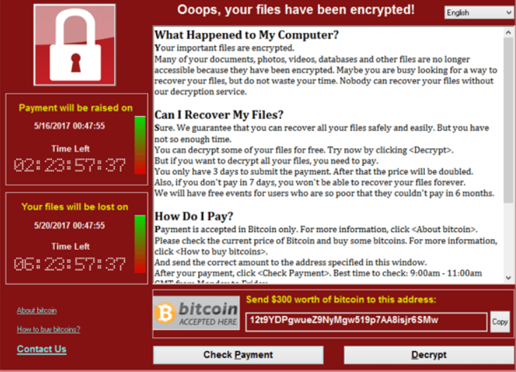
Scenario 1.3: The ransomware KA: https://www.cybok.org/media/downloads/Malware_Attack_Technologies_v1.0.1.pdf
Evan inserts the USB into his PC and sees the pdf entitled ‘Redundancies-2023’. Evan double clicks the file to open it up and the file disappears.
Evan is confronted by a ransomware message:
Notes:
Hand out laminated version of this for groups to read. Collect discussion notes after 15min.

Slide 11
Scenario 1.3: The ransomware KA: https://www.cybok.org/media/downloads/Malware_Attack_Technologies_v1.0.1.pdf
The ransomware is malicious software that encrypts a user's files making them unavailable. It is a security breach as it has broken the CIA (Confidentiality, Integrity and Availability) triad by making files unavailable, which has affected the integrity and availability of the data.
The ransomware has also gained ‘persistence’ on Evan's machine, by creating its own set of Windows keys inside the Windows registry. Evan tries several times to reboot his PC but the pop up remains.
Caroline Sweet is a colleague of Evan's, and the ransomware has spread to her machine. She immediately reports this to the security team.
Discussion point – Discuss the actions of Evan and Caroline. What immediate action should either of them have taken?
Notes:
Hand out laminated version of this for groups to read. Collect discussion notes after 15min.
Scenario 1.3 relates to the Malware and Attack Technologies KA. Areas to discuss include:
Types
CIA
Kill chain (covered later)
Malware analysis
Detection
Response

Slide 12
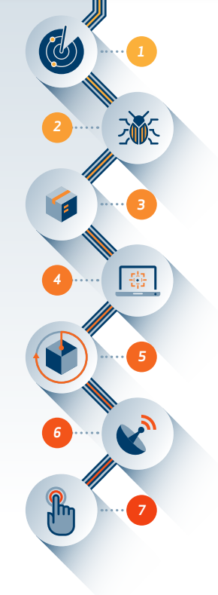
KA – Malware & Attack Technologies: Malware Activities – The Cyber Kill Chain https://www.cybok.org/media/downloads/Malware_Attack_Technologies_v1.0.1.pdf
Reconnaissance
Harvesting email addresses,
identifying vulnerable computers and accounts, etc
Weaponization
Designing exploits into a deliverable payload.
Delivery
Delivering the exploit payload to a victim via email,
Web download, etc.
Exploitation
Exploiting a vulnerability and
executing malicious code on the victim’s system.
Installation
Installing (additional) malware on the victim’s system.
Command & Control
Establishing a command and control channel for attackers to remotely commandeer the victim’s system.
Actions on Objectives
Carrying out malicious activities on the victim’s system and network.
Notes:
Explain what the Cyber Kill Chain is briefly (in case attendees have not encountered it before). There is a task later to map the scenario to this.

Slide 13
Scenario 1.4: Incident response KA: https://www.cybok.org/media/downloads/Security_Operations_Incident_Management_v1.0.2.pdf
Seymour Johnson works in the Security department of Mordor District council as a security analyst.
After receiving a telephone call from Caroline, his first action is to follow incident reporting procedure by creating an incident at a Level 1 priority on the internal incident reporting system, and reporting this to senior managers by email. He then removes every machine in the IT Support department from the network.
However, several other users across other departments, finance and administration have also had their machines infected.
After receiving further calls from other colleagues across the corporate estate, the decision is made to take down the corporate network.
Discussion – Could Seymour have taken more immediate remediation to prevent the spread of the ransomware? Discuss the incident reporting procedures in place in your organisation. What security solutions do you think could have prevented the malware infection and propagation?
Notes:
Hand out laminated version of this for groups to read. Collect discussion notes after 15min.
Prompts to aid discussion:
How might your organisation have managed this incident?
Are there any flaws in how this example was dealt with?

Slide 14
KA - Security Operations and Management: Incident Management https://www.cybok.org/media/downloads/Security_Operations_Incident_Management_v1.0.2.pdf
Prepare
Establish Policies & Procedures
Establish Operational Capabilities (People/Tools)
Incident Management
Return to Normal Operations
Follow Up
Handle
Identify & Implement lessons learnt
Communicate
Analyse
Mitigate
Notes:
Scenario 1.4 relates to the Security Operations and Incident Management KA. Relevant things to discuss from this KA include:
Analysis methods
Anomaly detection
SIEM (Plan)
Mitigation (Execute)
Counter measures (IPS)
SOAR
Honey Pots
Human Factors
Prepare – Handle – Follow up
Did the organisation have enough Sec Ops in place to defend against the attack? What would the follow up actions be?
How would the breach be reported?
For the rubber ducky scenario, Intrusion Prevention Systems should have been in place

Slide 15
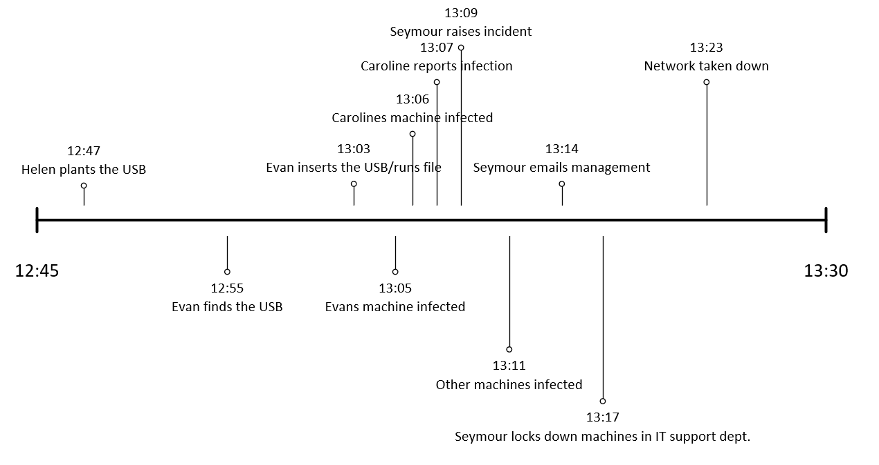
Scenario 1: Timeline
‘
Notes:
Hand out laminated version of this for groups to read. Collect discussion notes after 15min.
The NCSC IR timeline is useful to highlight here: https://www.ncsc.gov.uk/collection/incident-management/appendix-incident-timelines

Slide 16
Scenario Summary: The Cyber Kill Chain Context – Complete the sections in white with the actions taken by Helen and Evan for each of the CKC steps below.
Reconnaissance
Weaponization
Delivery
Exploitation
Installation
Command & Control
Actions on Objectives
Notes:
Ask attendees to map the scenario stage 1.1 – 1.4 to the Cyber Kill Chain
Reconnaissance – Helen would have been aware of internal IT systems, and potentially vulnerabilities based on device OS etc. However most of her reconnaissance was based around social engineering Evan as he was the human factor who was a vulnerability.
Weaponization - Her weaponization was ransomware which she could have easily obtained via the dark web. It is unlikely that Helen would have designed and implemented her own exploit.
Delivery - Her delivery was in the form of a rubber ducky USB.
Exploitation - She exploited the vulnerabilities that exist firstly in USB ports being enabled, and potentially no IPS/IDS in place. But Evan was the human vulnerability she exploited.
Installation - The installation was carried out by Evan when he inserted the USB and opened the file.
Command and Control - The command and control channel was obtained through the ransomware, although there was no remote access to internal systems.
Actions on Objectives - The malicious activities were the encryption of the host machines files and the ransom for payment of bitcoins.
**Summary – the organisation did not have sufficient mitigations in place. Outside of the cyber kills chain – the human factor was the biggest influence on the root cause – Helen. Could the organisation have done more considering the working environment, workloads and pressures etc that Helen experienced.
Hand out print off so groups can fill in the blanks.
In groups, complete the sections next to each of the 7 Cyber Kill Chain steps in the context of Helen and Evans actions.
Think about how your organisation could have prevented this attack – (*The CKC is based around having mitigation in place for any one of the steps which will break the attack chain)

Slide 17
CyBOK Overview: Knowledgebase Areas
Notes:
Our chosen KAs under the first phase of this project:
Adversarial Behaviours
Human Factors
Malware & Attack Technologies
Security Operations & Incident Management
Why?
These KAs represent the steps involved in a security breach/cyber attack.
i.e. Adversary is the threat>
Human Factors provide the (human) opportunity for an attacker>
Malware is the source>
Security Operations is the protection and response.
Mention here how these KAs can help organisations understand the key factors, processes, implications of any particular area. The scenarios given are intended to be appropriate to the attendees, but CyBOK has 21 KAs in total and a number of these will also be relevant, though they haven't been specifically covered here. Encourage the attendees to visit the CyBOK website and mention that there are a number of resources available to use / learn about the KAs.

Slide 18
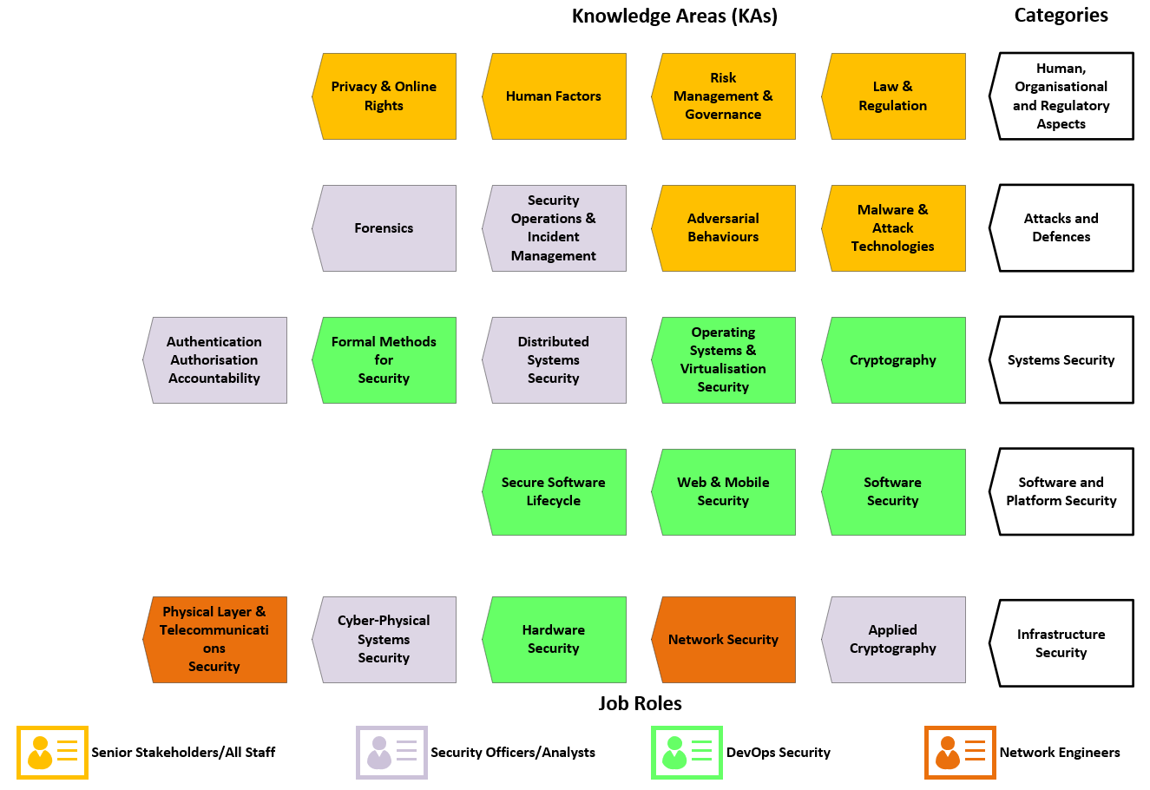
Knowledge Areas (KAs) Mapping to Job Roles
Notes:
Each colour-coded KA here maps to examples of job roles within an organisation.
The job roles are not inclusive, and for this presentation we are focusing on Senior Stakeholders/All Staff.
Feedback – which of the other KAs would the audience like to see in other phases/workshops?

Slide 19
What Next?
This workshop has been the first phase of the planned deliverable to explore CyBOK with established partners in the Education and Local Authority sectors. We have focused on only four of the KAs represented in the CyBOK knowledge base. We are planning to deliver further phases delivering workshops based around some of the other KAs. Your feedback on this workshop is greatly appreciated, and will steer our decisions on other KAs to deliver on in the future.

Slide 20
Resources
CyBOK Home Page - https://www.cybok.org/
CyBOK KAs - https://www.cybok.org/knowledgebase1_1/

Slide 21
THANK YOU FOR ATTENDING!!
Any Further Questions?

Slide 22
Our Expertise
We have experience working with academia to developing degree programmes that align with CyBOK, and certified by the NCSC.
Through our work in the defence section, we have a strong background in secure communications and a thorough understanding the importance of cyber security awareness.
We have existing relationships with Local Authorities responsible for education networks and Welsh Government Education teams.

