Slide 1
CyBOK e-Book:
Feasibility Study
Lőrinc Thurnay

Slide 2

Hi!
Lőrinc Thurnay (Lawrence)
research associate
Department for E-Governance and Administration
Research interests:
Open data applications
Open legal data
ML/NLP
Cyber-security
thurnay@protonmail.com

Slide 3
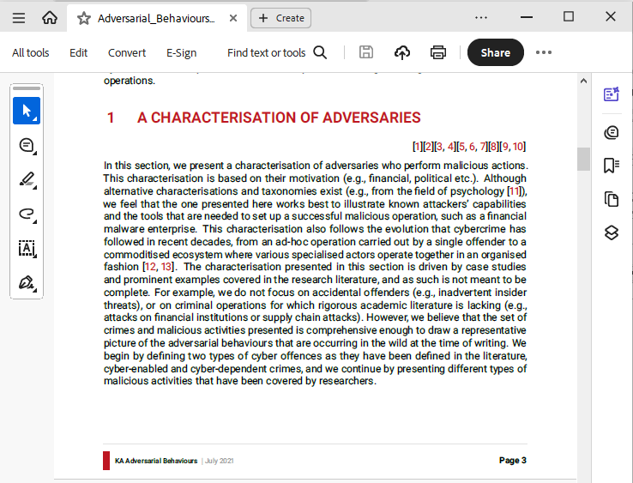
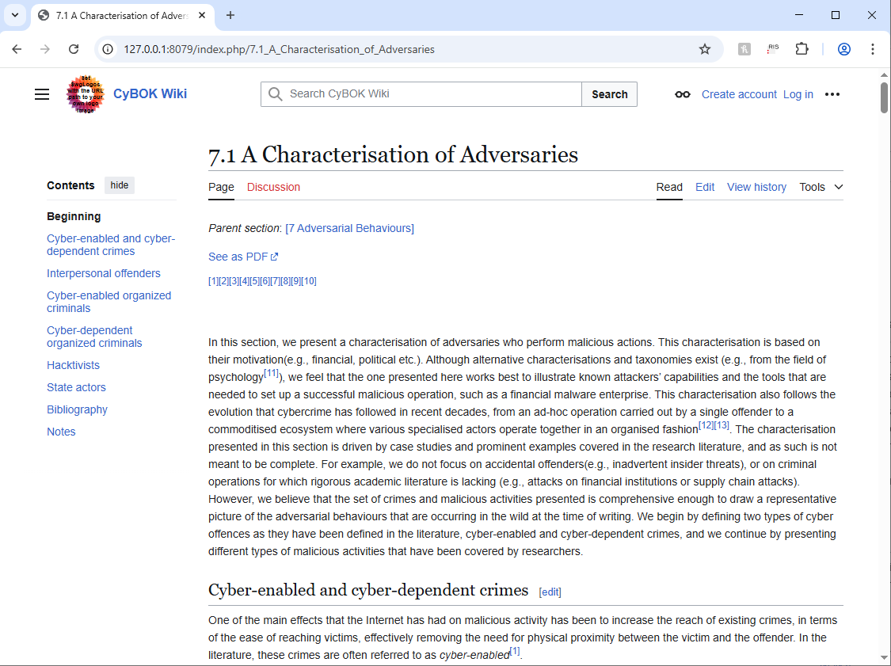
Motivation
CyBOK is >1000 pages
  User eXperience
  Accessibility
  Discoverability
PDF
Wiki
(work in progress)
Notes:
Curriculum development

Slide 4
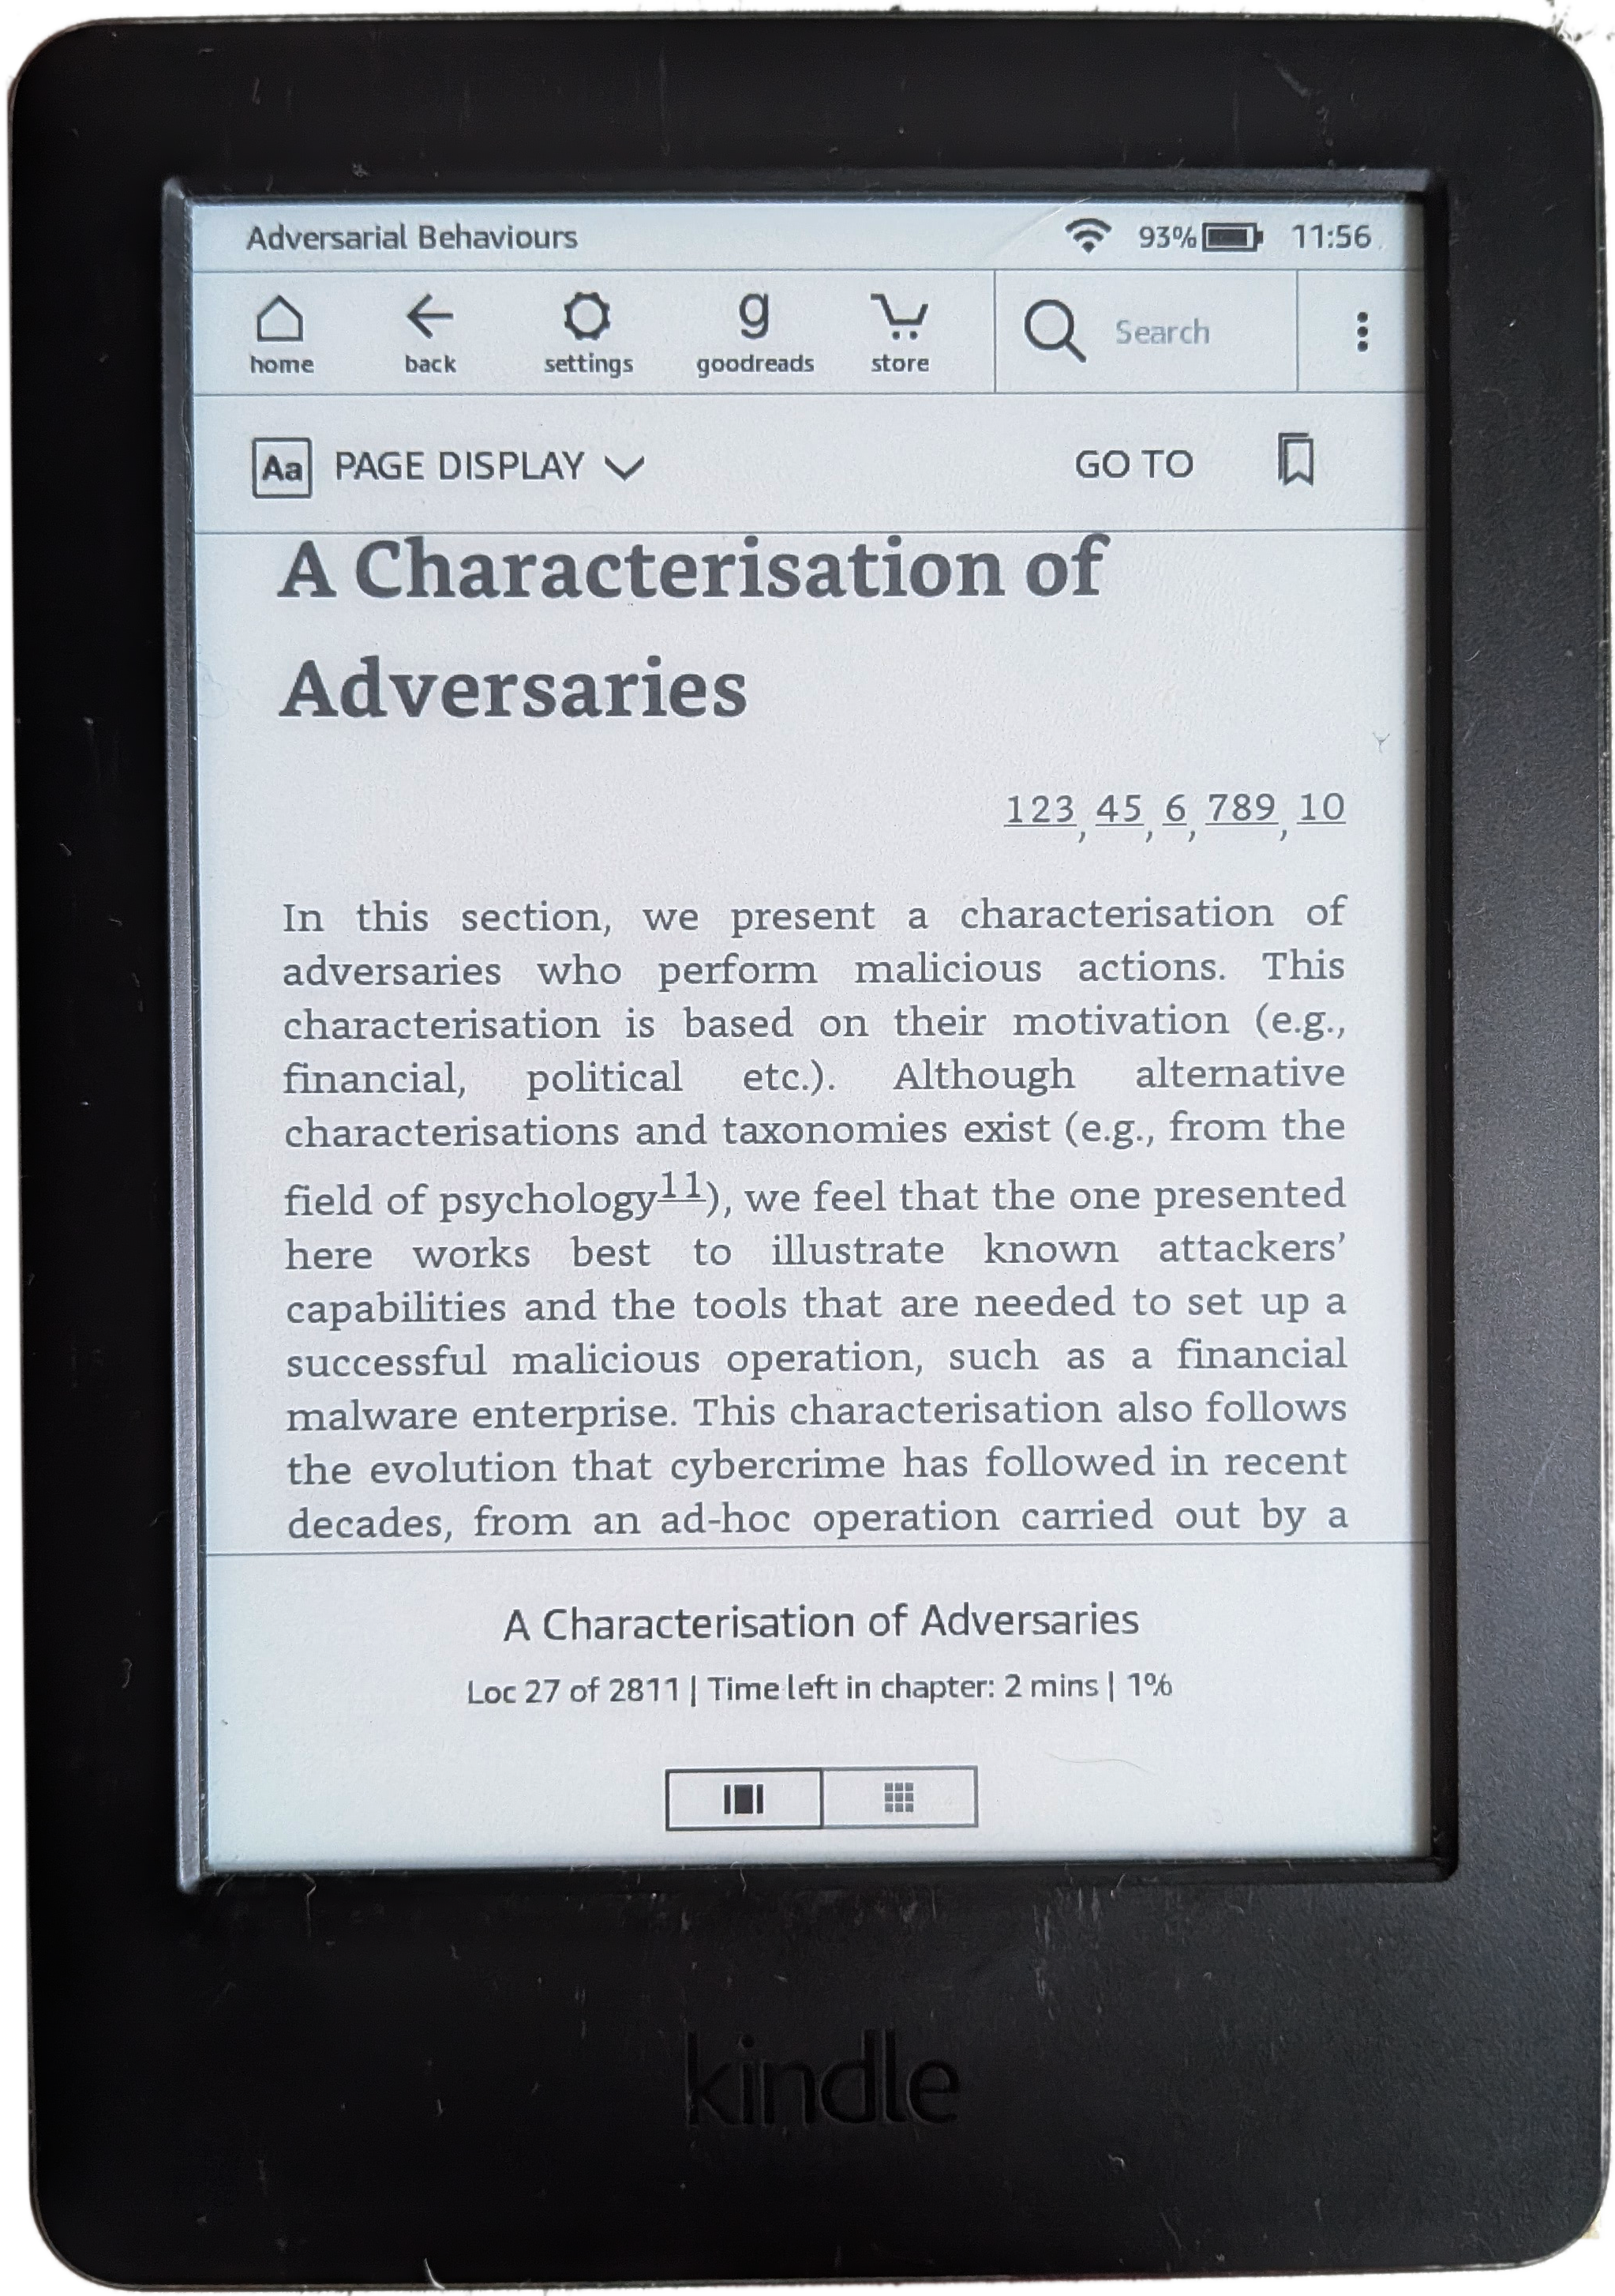
PDF
e-book
Wiki
(work in progress)
Notes:
Curriculum development

Slide 5



Open, leading standard
  Zipped XML/xHTML, CSS, Javascript
Typically e-reader: device designed for reading
  May look & behave differently
  Paper-like display, lasts weeks with one charge
Notes:
Curriculum development

Slide 6
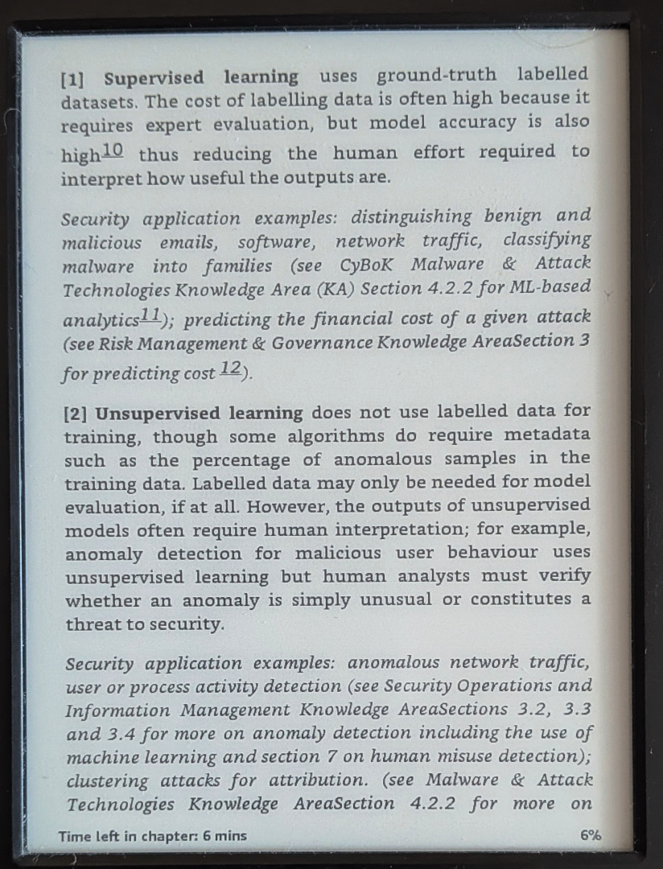
Open, leading standard
  Zipped XML/xHTML, CSS, Javascript
Typically e-reader: device designed for reading
  May look & behave differently
  Paper-like display, lasts weeks with one charge
Hypertext with formatting and structure
Notes:
Curriculum development

Slide 7
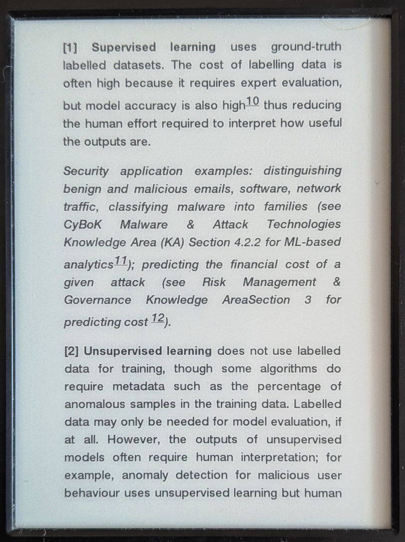
Open, leading standard
  Zipped XML/xHTML, CSS, Javascript
Typically e-reader: device designed for reading
  May look & behave differently
  Paper-like display, lasts weeks with one charge
Hypertext with formatting and structure
Customizable typesetting
Notes:
Curriculum development

Slide 8
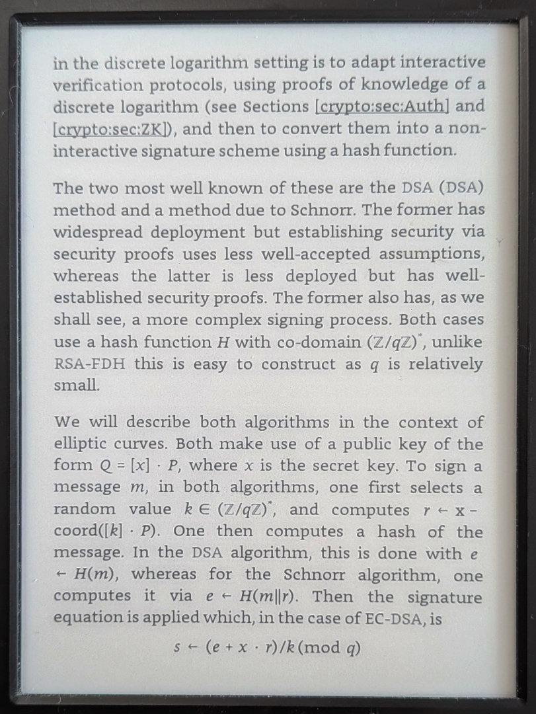
Open, leading standard
  Zipped XML/xHTML, CSS, Javascript
Typically e-reader: device designed for reading
  May look & behave differently
  Paper-like display, lasts weeks with one charge
Hypertext with formatting and structure
Customizable typesetting
Math
Notes:
Curriculum development

Slide 9
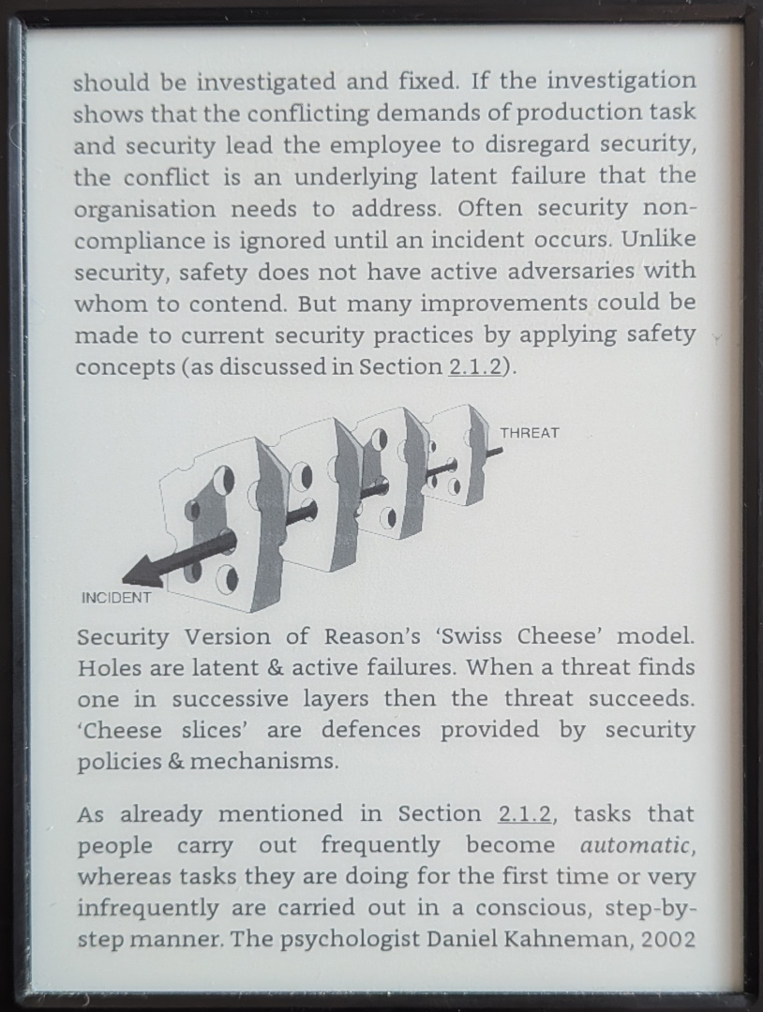
Open, leading standard
  Zipped XML/xHTML, CSS, Javascript
Typically e-reader: device designed for reading
  May look & behave differently
  Paper-like display, lasts weeks with one charge
Hypertext with formatting and structure
Customizable typesetting
Math
Pictures
Notes:
Curriculum development

Slide 10
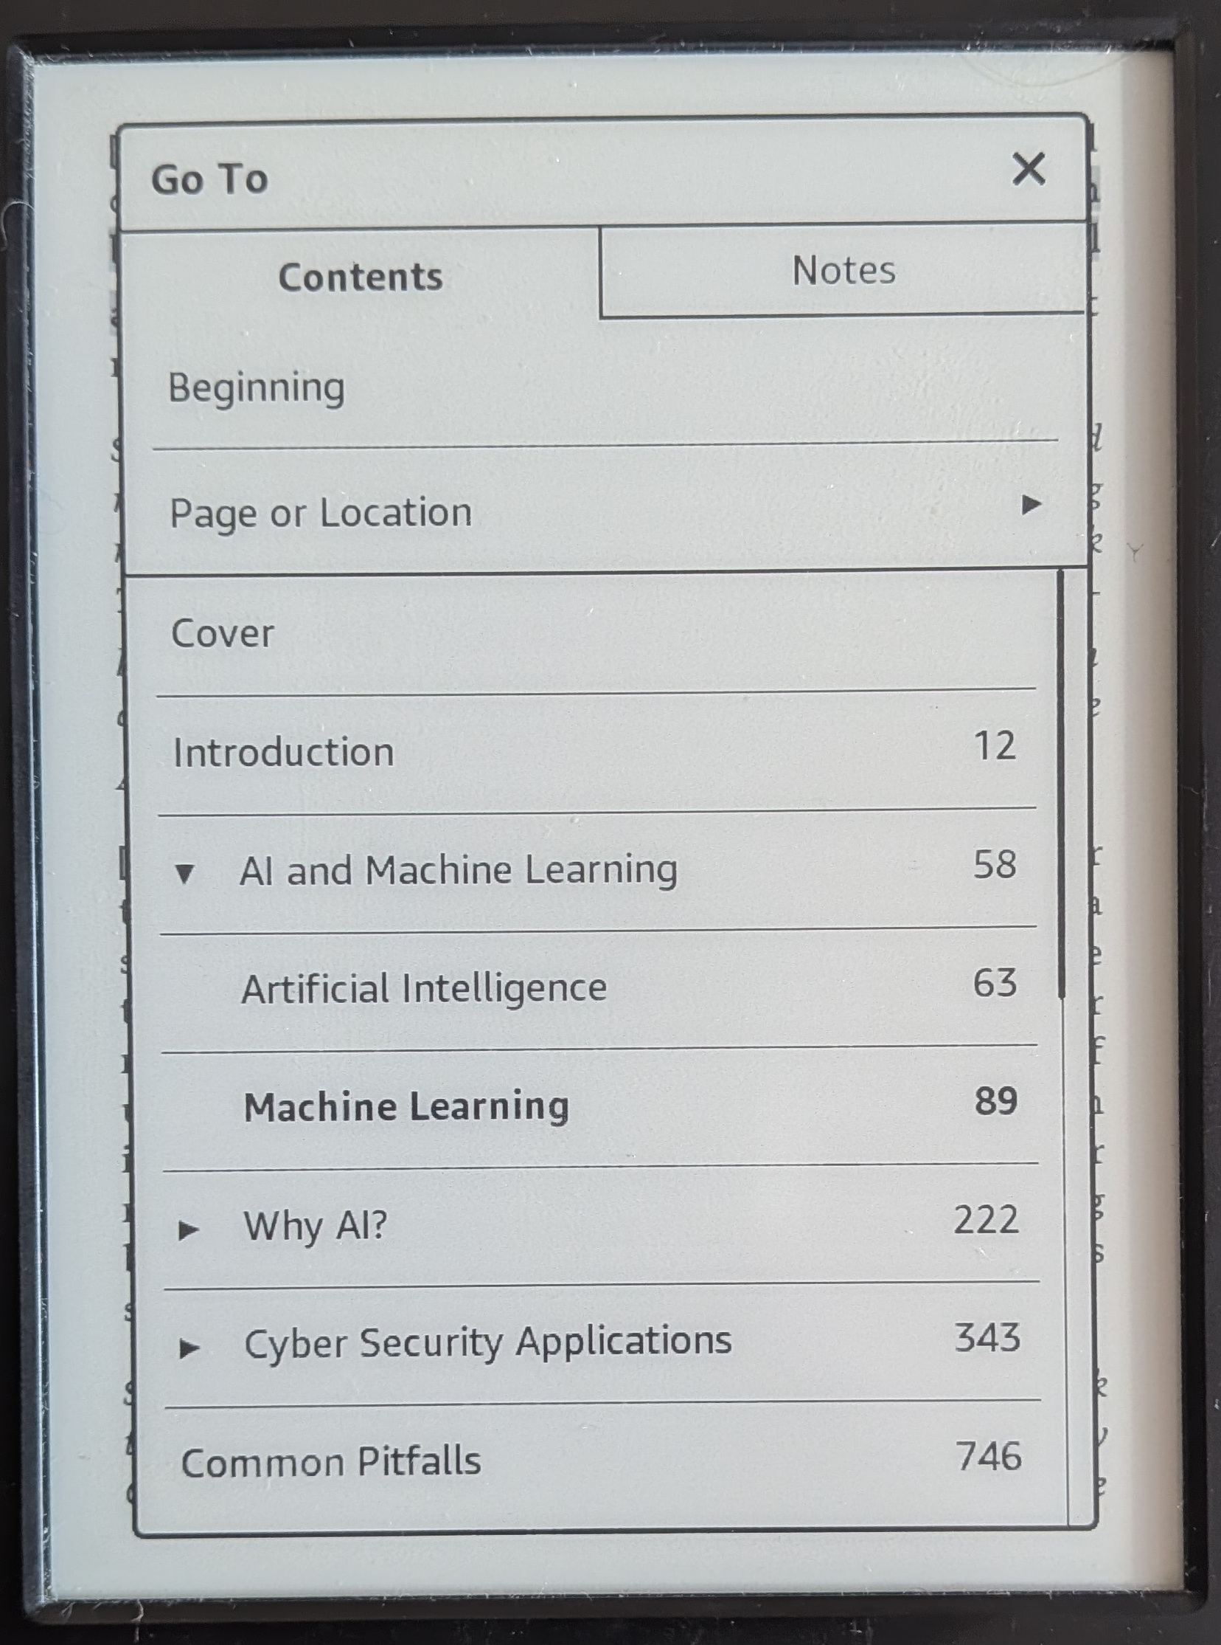
Open, leading standard
  Zipped XML/xHTML, CSS, Javascript
Typically e-reader: device designed for reading
  May look & behave differently
  Paper-like display, lasts weeks with one charge
Hypertext with formatting and structure
Customizable typesetting
Math
Pictures
Navigation
Notes:
Curriculum development

Slide 11
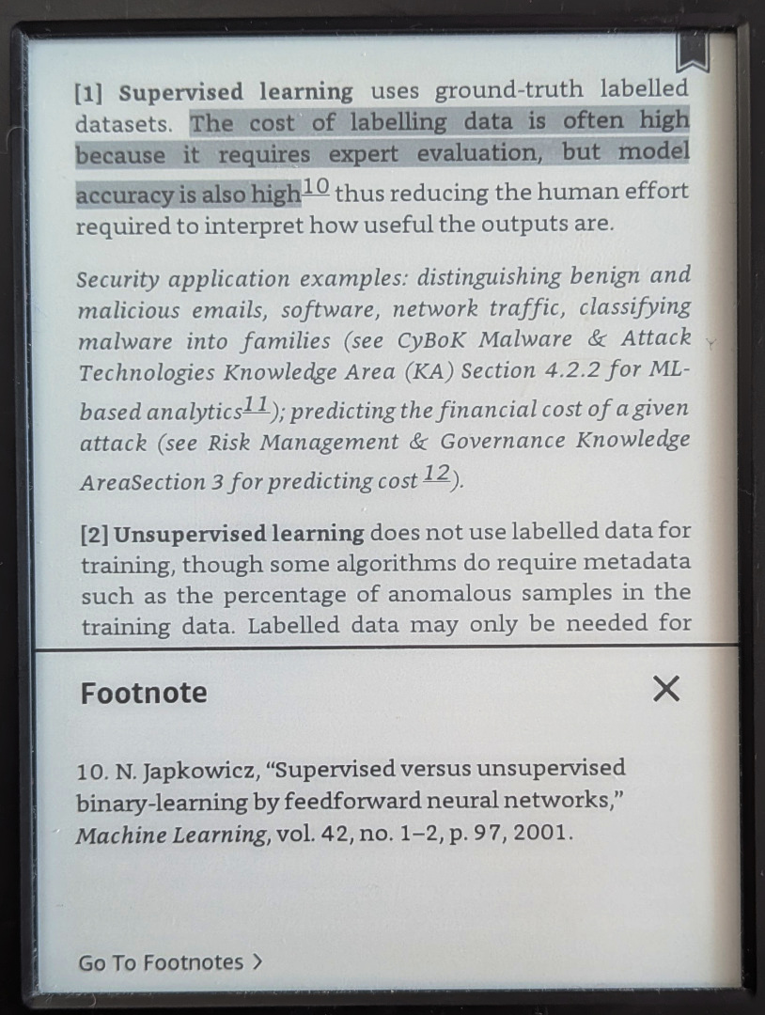
Open, leading standard
  Zipped XML/xHTML, CSS, Javascript
Typically e-reader: device designed for reading
  May look & behave differently
  Paper-like display, lasts weeks with one charge
Hypertext with formatting and structure
Customizable typesetting
Math
Pictures
Navigation
Pop-up footnotes & bibliography
Highlights, note taking
Bookmarks...
Notes:
Curriculum development

Slide 12
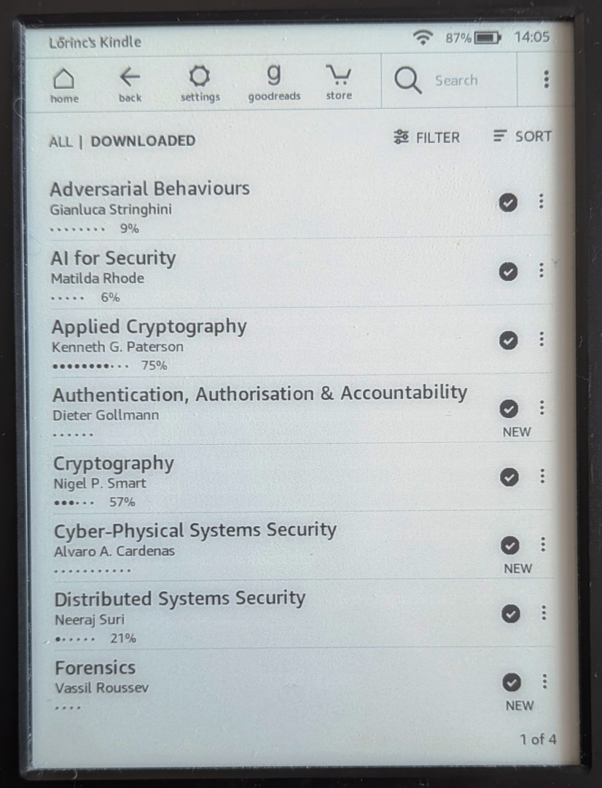
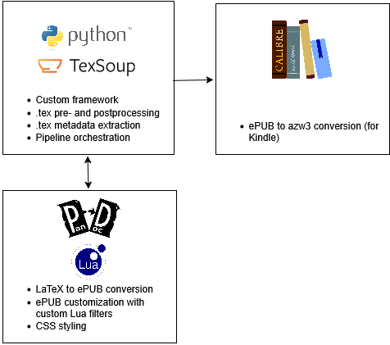


Feasibility study
22 knowledge areas and 3 supplementary guides
Built on the CyBOK Wiki codebase
Proof-of-concept – lots to iron out
Technically feasible
SW stack of CyBOK e-book
Prototype software
Notes:
Curriculum development

Slide 13
The case for e-books
E-Readers: $7b global market¹
30% of Americans read e-books²
Devices designed for reading
  Paper-like display
  Lasts weeks with one charge
  Sync reading location to smartphone
  No UI or app noise
  Accessibility: text-to-speech, dyslexic-friendly font
Integrated discovery/delivery ecosystem
  Kindle: does not support ”sale” of free books³
  Kindle: manual file loading (cable, wifi) or send-by-email method
  Kobo: (dominant in Canada):
  Free e-books are and Crown licence is (probably) fine^{4,5}
¹https://www.mordorintelligence.com/industry-reports/e-reader-market
²https://www.pewresearch.org/short-reads/2022/01/06/three-in-ten-americans-now-read-e-books
³https://kdp.amazon.com/en_US/help/topic/G200641280
⁴https://kobowritinglife.zendesk.com/hc/en-us/articles/360059386011-How-to-make-your-book-available-for-free
⁵https://cdn.kobo.com/merch-assets/writinglife/KOBO/en-US/serviceAgreement.html

Slide 14

Open questions
Segmentation
  For this study, each KA is a separate e-book.
  Whole CyBOK as one ebook?
  5 KA groups as separate ebooks?
  Size, navigation
Interactive behavior:
  References, glossaries, notes as pop-ups, or endnotes?
Chapter numbering?
PDF original
like PDF original | ...explained in Section 7.2...
with number and title | ...explained in Section 7.2 "A Characterisation of Adversaries"...
only title | ...explained in Section "A Characterisation of Adversaries"...
removing Section prefix | ...explained in "A Characterisation of Adversaries"...

Slide 15
Next steps
Implementation
  Systemic review of the whole codebase
  Iterative feedback loop with stakeholders
Thank you!
Lőrinc Thurnay (Lawrence)
research associate
Department for E-Governance and Administration
thurnay@protonmail.com

