Slide 1
Project for mapping of
Information Security BOK (IS-BOK), Singapore & Cyber Security BOK (CyBOK), UK
Professor Steven Wong
Dr Yulia Cherdantseva

Slide 2
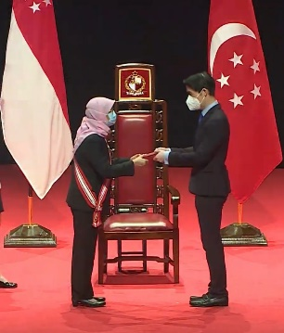



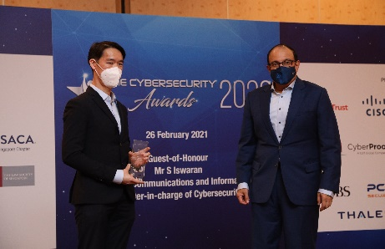




Brief Introduction of Speaker
Dr. Steven Wong
Professor, ICT Cluster
Director, Centre for Digital Enablement (CoDE)
Former Deputy Cluster Director, ICT Cluster
Former Programme Director (Information Security)
Former Programme Director (Software Engineering)
Deputy Chairman
Coordinating Committee for Cybersecurity (CCCY)
Immediate Past President & Advisor to EXCO
Association of Information Security Professionals (AiSP)
Public Administration Award (Bronze) - This is a national award for public service which was presented
by President Halima Yaacob of Singapore
Notable Awards & Accolades
The Cybersecurity Awards, Winner (Leader Category), 2020
National Day Awards, Public Administration Medal (Bronze), 2020
The Cybersecurity Awards Presented by Minister-in-charge of Cybersecurity, Mr S.Iswaran
Other notable current/past appointments in Singapore/APAC organisations and associations:
Chairman (Founding), APAC Education Council, Cloud Security Alliance
Co-Chairman, WG3 Telecommunications Standards Advisory Committee, Infocomm and Media Development Authority of Singapore (IMDA)
Co-Chairman (Founding), Council of Registered Ethical Security Testers (Singapore)
Founding Board Member (Founding), Cloud Security Alliance (Singapore)
Chairman, IEEE Consumer Electronics Society (Singapore)
Member, Cybersecurity Advisory Group to Minister-in-charge of Cybersecurity, Ministry of Communications and Information

Slide 3
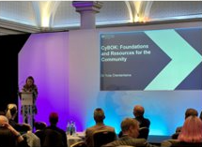








Brief Introduction of Speaker
Dr. Yulia Cherdantseva
Associate Professor, Centre for Cyber Security Research
Director, Academic Centre of Excellence in Cyber Security Education ​
​Co-Director, Digital Transformation Innovation Institute ​
Co-Director, Hartree Centre Cardiff Hub​
Cardiff University​
Former Programme Director (Cyber Security, Cyber Security & Technology)​
Executive/Editorial Board Member
Notable Awards & Accolades
Outstanding Contribution Award, 2021 and 2022, Cardiff University
Best Academic Programme of the Year, FinTech Wales, 2022

Slide 4
Agenda
Mapping of AiSP IS-BOK with UK’s CyBOK
Background
Introduction to BOKs
Aims, Objectives and Work Packages
Some Preview of Current Work

Slide 5
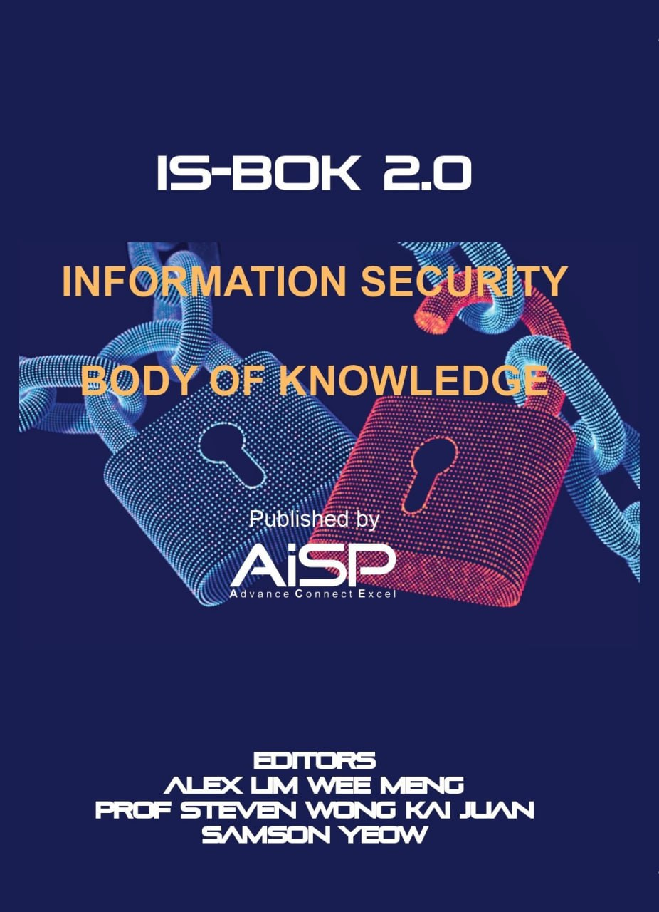

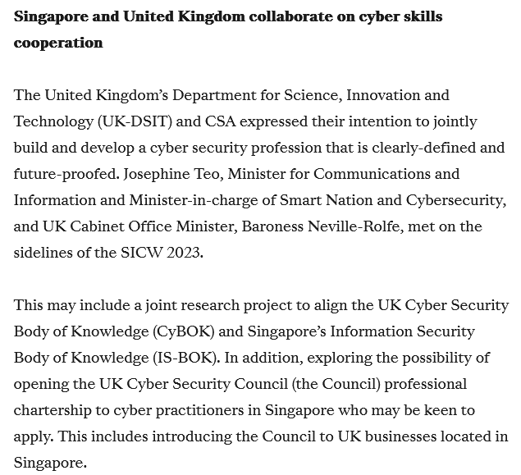
Background
First mentioned at SICW2023 by Minister Josephine Teo
Project started 15 Aug 2025 with support from:
  Cyber Security Agency of Singapore (CSA)
  Foreign, Commonwealth & Development Office (FCDO), UK
  Department of Science, Innovation & Technology (DIST), UK

Slide 6
Introduction to BOKs
CyBOK – Led by Academia (University of Bristol)
Initiated in 2017, CyBOK is a comprehensive framework that defines the foundational knowledge in cybersecurity. Funded by the UK’s National Cyber Security Programme and led by the University of Bristol, the CyBOK initiative was developed through extensive collaboration between academia and industry. It consolidates key concepts across 21 knowledge areas. 115 industry and academic experts contributed to CyBOK, creating the largest free resource in cybersecurity under the motto For the Community, By the Community.
In the UK, CyBOK has a significant impact on shaping national cybersecurity capability: it underpins degree accreditation and assured training certification schemes, as well as Academic Centres of Excellence (ACE) schemes run by the UK's National Cyber Security Centre (NCSC), helping to standardize and elevate the quality of cybersecurity education and professional development.
IS-BOK – Led by the Industry
Developed in 2009 to support the development of the cybersecurity profession in Singapore, the IS-BOK was utilised to design the Qualified Information Security Professional (QISP®) Programme. The QISP® examination enables the professionals in Singapore to attest their knowledge and was supported by IDA (now IMDA) towards professionalization. The IS-BOK was updated to version 2.0 in 2021 and QISP® training and certification was also revamped working with training partners to develop courseware for online and classroom training in Singapore and overseas.
IS-BOK was used for curriculum review for Institutes of Higher Learning (IHLs) in Singapore. There is also regional interest resulting in the translation of the IS-BOK by the various cybersecurity associations in the region into various native languages such as Bahasa Melayu with Brunei Cybersecurity Association (BCSA), Bahasa Indonesia with and Asosiasi Pengusaha TIL National (APTIKNAS) and Vietnamese with VNISA.

Slide 7

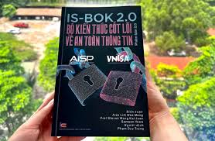
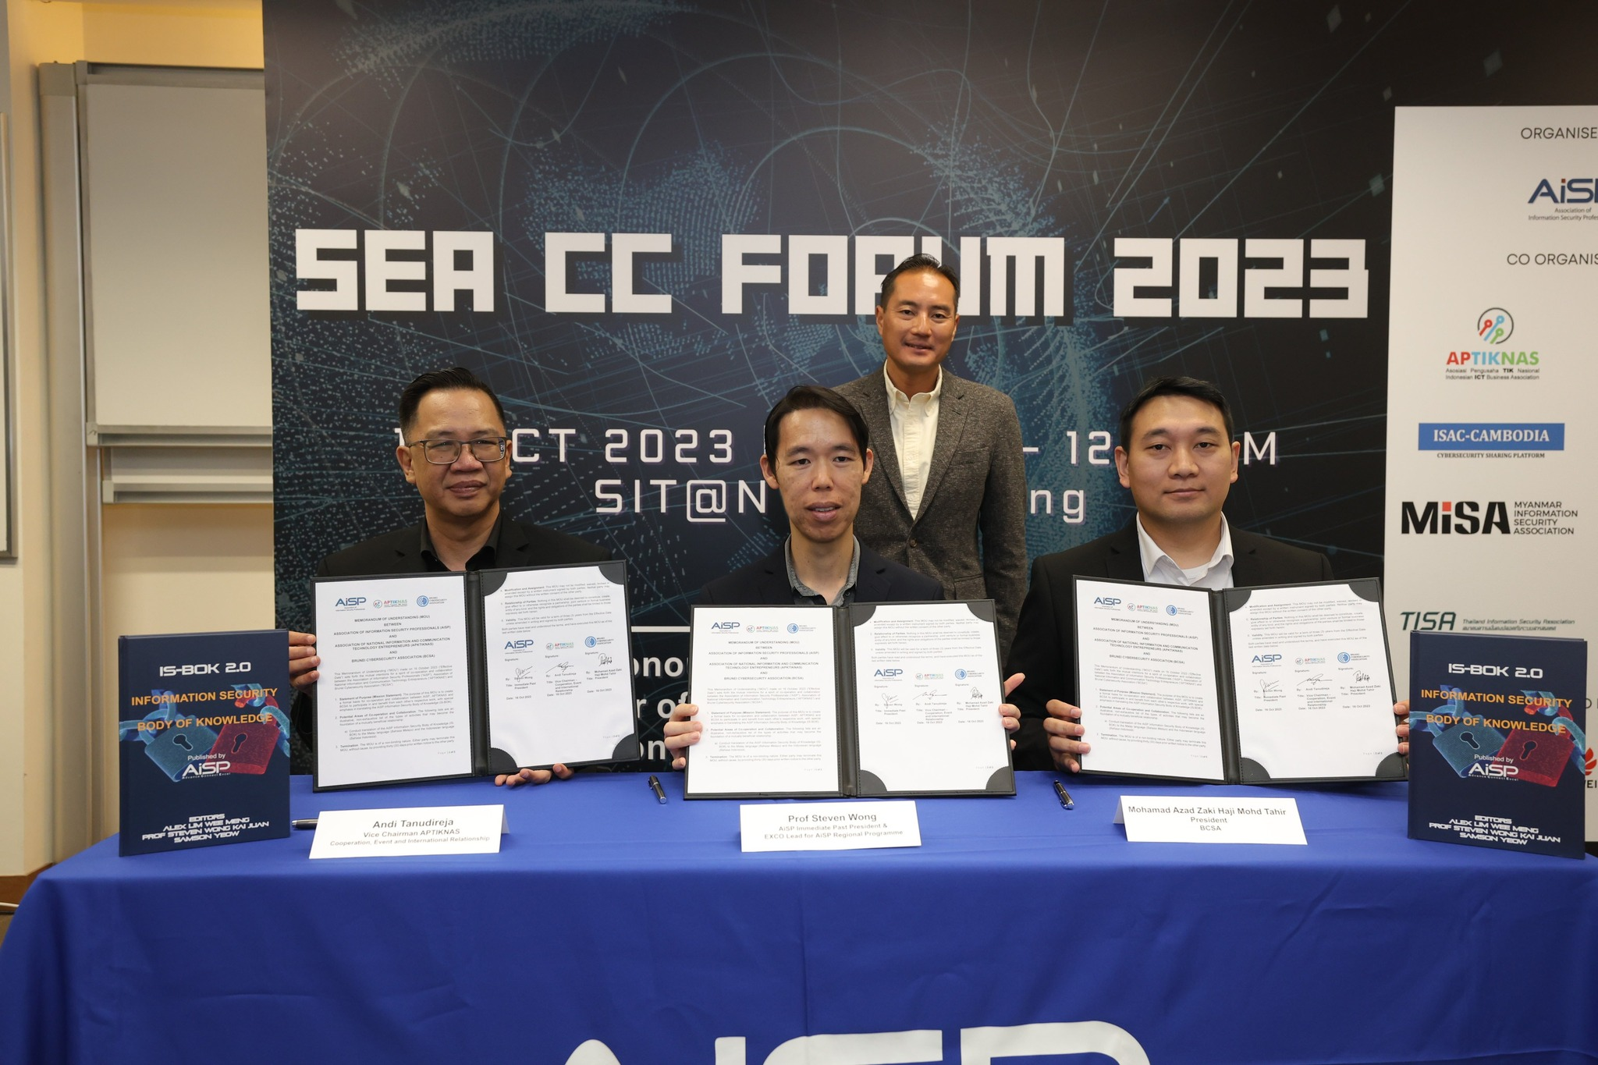
Information Security Body of Knowledge (IS-BOK) 2.0
Information Security Body of Knowledge (IS-BOK) 2.0
Bridging Knowledge Framework and Certification for IT Professionals moving into Information Security
Enhance knowledge for practitioners and interested parties through knowledge-sharing events based on BOK topics.
Assurance through industry validation for IS-BOK 2.0.
The stakeholders’ input together with our consultation with MOU partners would enable us to cross recognise IS domains for Singapore professionals in the region.
The Core Modules are used for courseware development for the updated Qualified Information Security Professional (QISP®) certification.
This serves as a platform for ease of access to experts in the different domains as well as to gain visibility into the concerns of industry.
Q4 2017 – Q4 2021
BOK1.0 >>> BOK2.0
Q4 2021 – Q2 2023
Develop Courseware for QISP Certification & Validation on Core Modules
Q2 2023
Launching of QISP based on BOK2.0
Contributions from over 40 industry and academic experts
Available online on Rakuten Kobo
Hardcopy available via AiSP (400+ pages)
Translated to native languages by regional cybersecurity associations

Slide 8

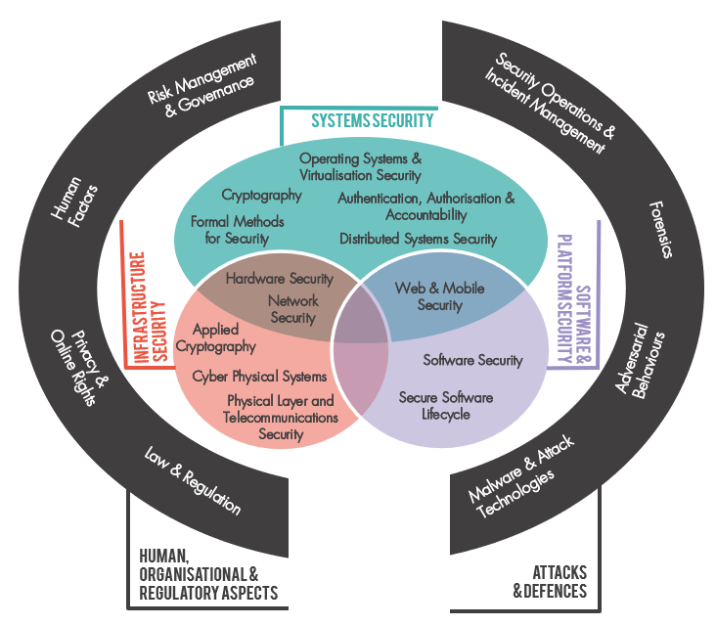

Cyber Security Body of Knowledge (CyBOK v1.1)
www.cybok.org
The CyBOK corpus includes:
The BOK with 21 Knowledge Areas
Supplementary Guides:
  AI for Security
  Security & Privacy of AI
  Security Economics
Mapping Framework and Exemplars
Education and Outreach Materials
1000+ pages and 2200+ references

Slide 9
Aims & Objectives
The key objective of this initiative to identify synergies and differences in the IS-BOK and UK CyBOK together with the UK team as well as a means to sustainable collaboration moving forwards.
WP1: (WHAT)
Cross-mapping between IS-BOK and CyBOK to determine the alignment (commonality and differences) between CyBOK & IS-BOK
WP2: (HOW)
Evaluate the way CyBOK resources are utilized as well as proposal if the IS-BOK can do the same for Singapore.
Propose plans for collaboration between CyBOK and IS-BOK moving forwards as well as the role they may play in the future such as for mutual and community learning; support for national certification programmes and professionalisation in each country
Final report is currently targeted to be ready by 15 Feb 2026
Confidential – Do not recirculate

Slide 10
Work Package 1: The “WHAT”
Cross-mapping between IS-BOK and CyBOK to determine the alignment (commonality and differences) between CyBOK & IS-BOK. This work package may include the following work items:
  Analyse the structure of both BOKs
  Explore assumptions and scope, breadth and depth.
  Examine focus and aims of each BOK.
  Explore aims in terms of comprehensiveness and coverage.
  Examine approaches to covering emerging topics.
  Analyse the visual representations of BOKs.
Output: Technical Report (WP1)

Slide 11
Work Package 2: The “HOW”
Evaluate the way CyBOK resources are utilized as well as if the IS-BOK can do the same for Singapore. This work package may include the following work items:
  Evaluation of the BOK’s development processes
  Exploration of the maintenance and governance approaches
  Mechanisms for community involvement
  Updatability and agility of BOKs
  Online presence
  Considerations of use cases during the BOK design, e.g. role in education and training and curriculum design, role in professional certification.
Output: Technical Report (WP2)

Slide 12

Project Team Members
Singapore Team
Professor Steven Wong
Singapore Institute of Technology
Associate Prof Goh Weihan
Singapore Institute of Technology
Samson Yeow
Singapore Polytechnic
Terence Siau (Secretariat)
AiSP
UK Team
Professor Awais Rashid (CyBOK lead)
University of Bristol, UK
Associate Prof. Yulia Cherdantseva
Cardiff University and CyBOK Exec/Editorial Board, UK
Dr. Lata Nautiyal
University of Roehampton, London, UK
Dr. Marius-Constantin Ilau
University of Bristol, UK
Jenna Cox (Project Manager)
University of Bristol, UK

Slide 13
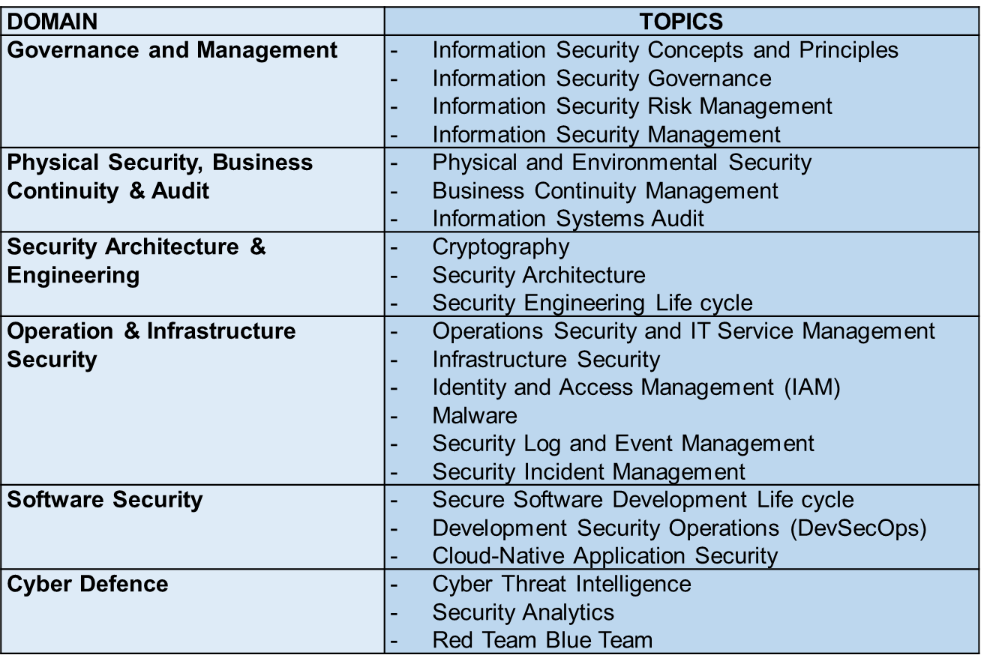
Comparisons: IS-BOK and CyBOK Areas
IS-BOK - 6 Domains, 22 Topics
CyBOK - 5 Domains, 21 Knowledge Areas
Not Trivial!!!!
Can be seen that the domains are classified differently but there exist some similarities and differences even in these overview diagrams. Also need to take into consideration emerging areas such as AI which is missing in both.
Confidential – Do not recirculate

Slide 14
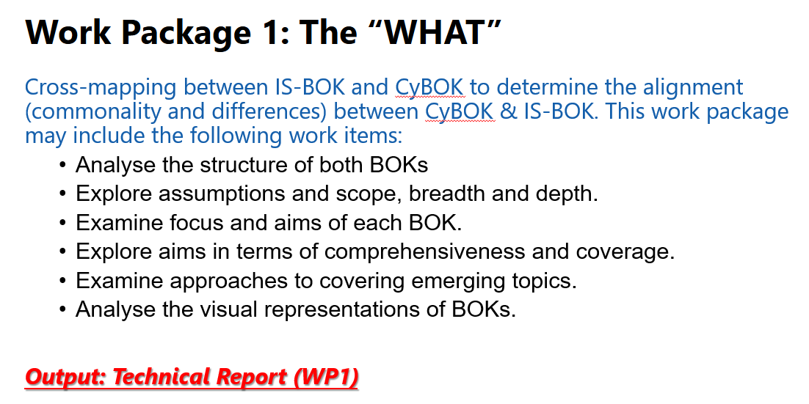
Comparisons of focus and aims
TOC-based comparisons of coverage
Knowledge-tree-based comparisons of coverage
Using CyBOK Mapping Framework

Slide 15
Comparisons of Focus and Aims
Possible inference by:
Comparisons by the affiliation of the contributors
Industry
Academic
Industry
Academic
Comparisons by the source of references (WIP-Preliminary)
Industry dominant (e.g. standards, whitepapers)
Local/regional focus (e.g. PDPA, CMCA, SG Regulations/Policies )
Academic dominant (e.g. conference proceedings, journals, etc)
Globally focused (e.g. broad coverage of knowledge areas)
Confidential – Do not recirculate

Slide 16
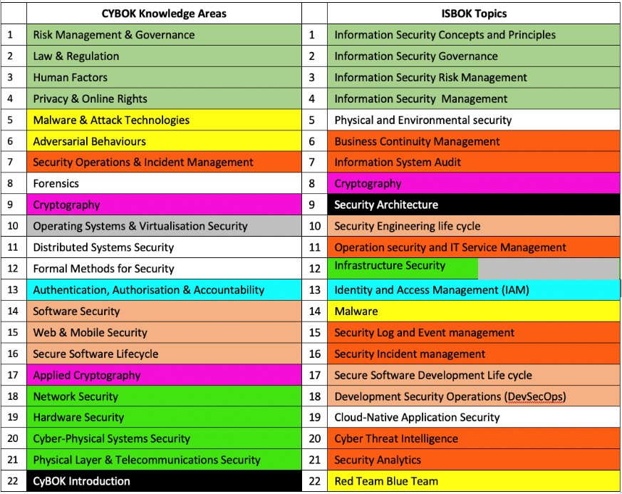
TOC-Based Comparisons of Coverage
There are knowledge areas and topics that are present in one, but not in the other as indicated with the white background

Slide 17
Headers-Based Comparisons of Coverage
CyBOK
Malware & Attack Technologies
(MAT)
IS-BOK
Malware

Slide 18
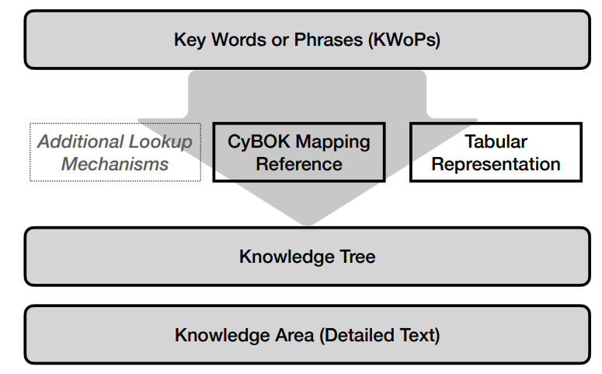
Using CyBOK Mapping Framework
https://www.cybok.org/usecases

Slide 19
Example of Mapping - Malware
IS-BOK Topic "Malware" (Core Module 4 – Operation and Infrastructure Security) mapped to CyBOK
KWoPs | CyBOK Mapping Reference OR Tabular Representation | CyBOK Knowledge Tree | CyBOK KA Text | Mapping Type
Malware | MAT | MAT\malware taxonomy\kinds | ** | Specific
Malicious software | MAT | MAT\malicious activities by malware | ** | Specific
Malware infection | MAT | MAT\ malicious activities by malware | ** | Specific
Compromise (system compromise) | MAT | ** | MAT- A TAXONOMY OF MALWARE - Page 3 | Conceptual
Malware basics | MAT | MAT\malware taxonomy\kinds | ** | Specific
Evolution of malware | MAT | MAT\malicious activities by malware | ** | Conceptual
Intention of malware creator | MAT | MAT\ malicious activities by malware | ** | Conceptual
Malware threats | MAT | MAT\malware taxonomy\kinds\ advanced persistent threats | ** | Specific
Types of malware | MAT | MAT\malware taxonomy\kinds | ** | Specific

Slide 20
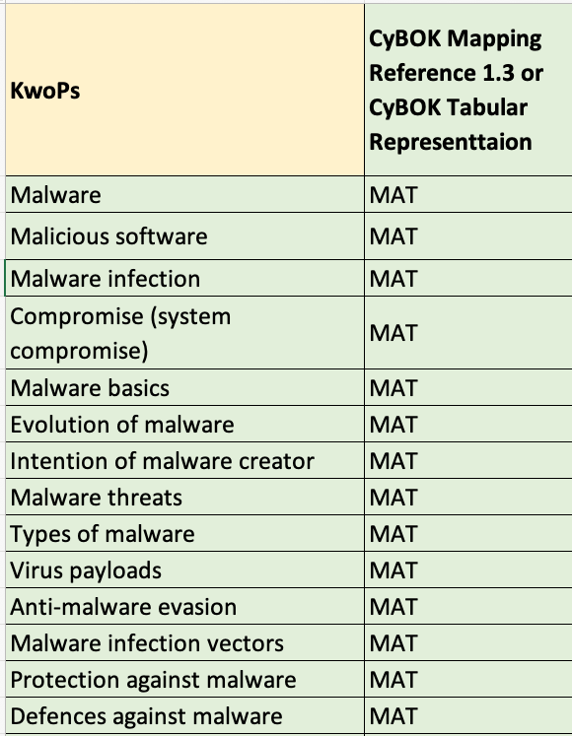
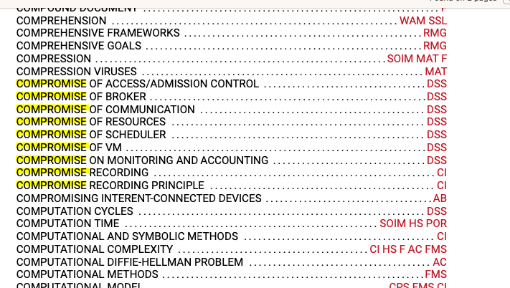
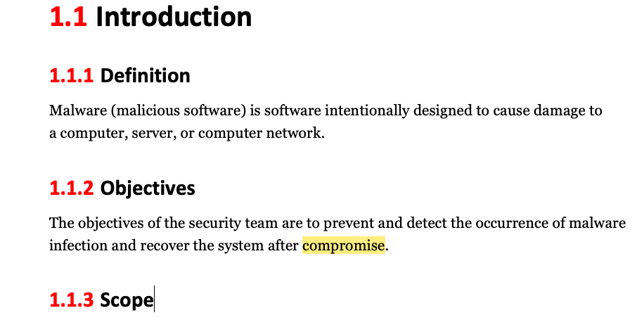
Example of Mapping - Malware
CyBOK
Mapping Reference
IS-BOK Text

Slide 21
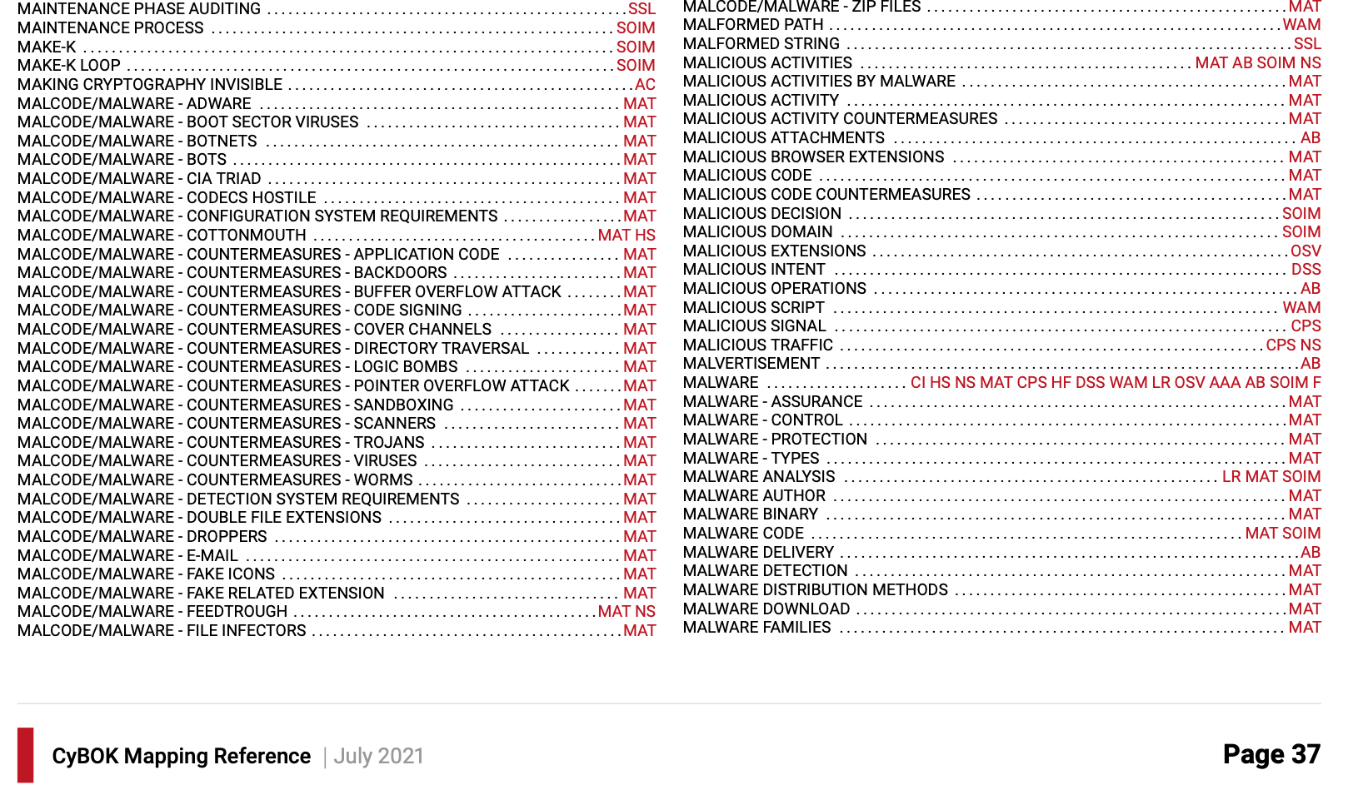
Example of Mapping - Malware

Slide 22
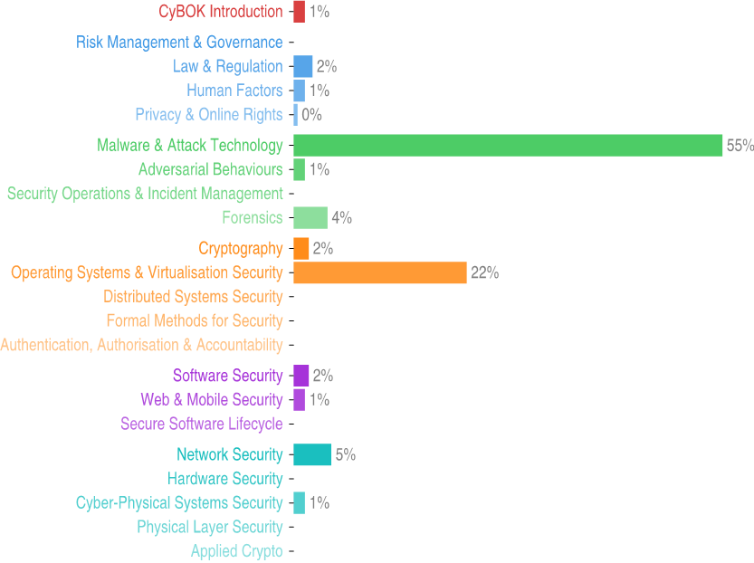
Example of Mapping - Malware
IS-BOK topic "Malware" mapped to CyBOK

Slide 23

More to come!
Interested to contribute to this project, the IS-BOK or CyBOK?
Contact us!!!
secretariat@aisp.sg
Connect

Slide 24
Thank you!

